Slide 1
Class presentations
FISH 554 Winter 2020

Slide 2
Kerry Accola

Slide 3
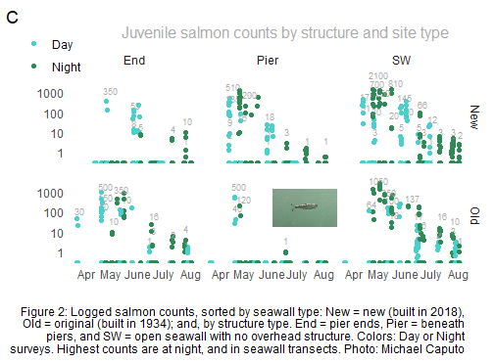
Notes:
Code for insetting photo. ggdraw(plot)+ draw_image(“photo", x=,y=,width=,height=)
Code for manually setting x-axis labels, since mine were actually by day of year. scale_x_continuous(breaks=c(point1,2,3,4,5),
labels=c(“Apr”,”May”,”June”,”July”,”Aug”)
Code for manually placing legend: theme(legend.position = c(-0.05, 1.1))
If anyone can help me putting a box around my legend, that’d be great! I tried rect(), annotate() all without success.

Slide 4
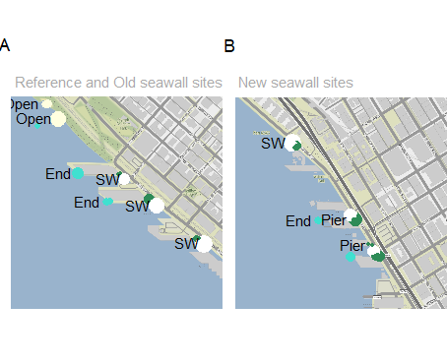
Map depicts salmon distributions (proportional to circle size) as they migrate along the Seattle waterfront past Reference (non-seawall), Old (built 1934), and New (built 2018) seawall sites. White=Seawall, Green=Pier, Turquoise=Pier ends, and Lightyellow=Reference.
Notes:
I need help with this. I could not find a way to make the legend small enough to inset it, so it’s currently removed even though it’s necessary. I would also prefer to keep all circles as one color, transparency based on counts. (I may go back to the original stat_density2d(geom=“polygon”) for this. I could also manually label each location with the total counts for that location. (?) Any help is appreciated. Below is some helpful code.
Code for color&size coding points: geom_point(data=data, aes(x=lon, y=lat, size=counts, color=structure type)
Code for choosing colors: scale_colour_manual(values=c(“color1",“color2",“color3",“color4"))
Code for arranging plots side-by-side: ggarrange(plot1, plot2) from package “ggpubr”
Code for labelling according to column: aes(label = paste(" ",as.character(column),sep="")),angle=0, etc.

Slide 5
Sabrina Aeluro

Slide 6
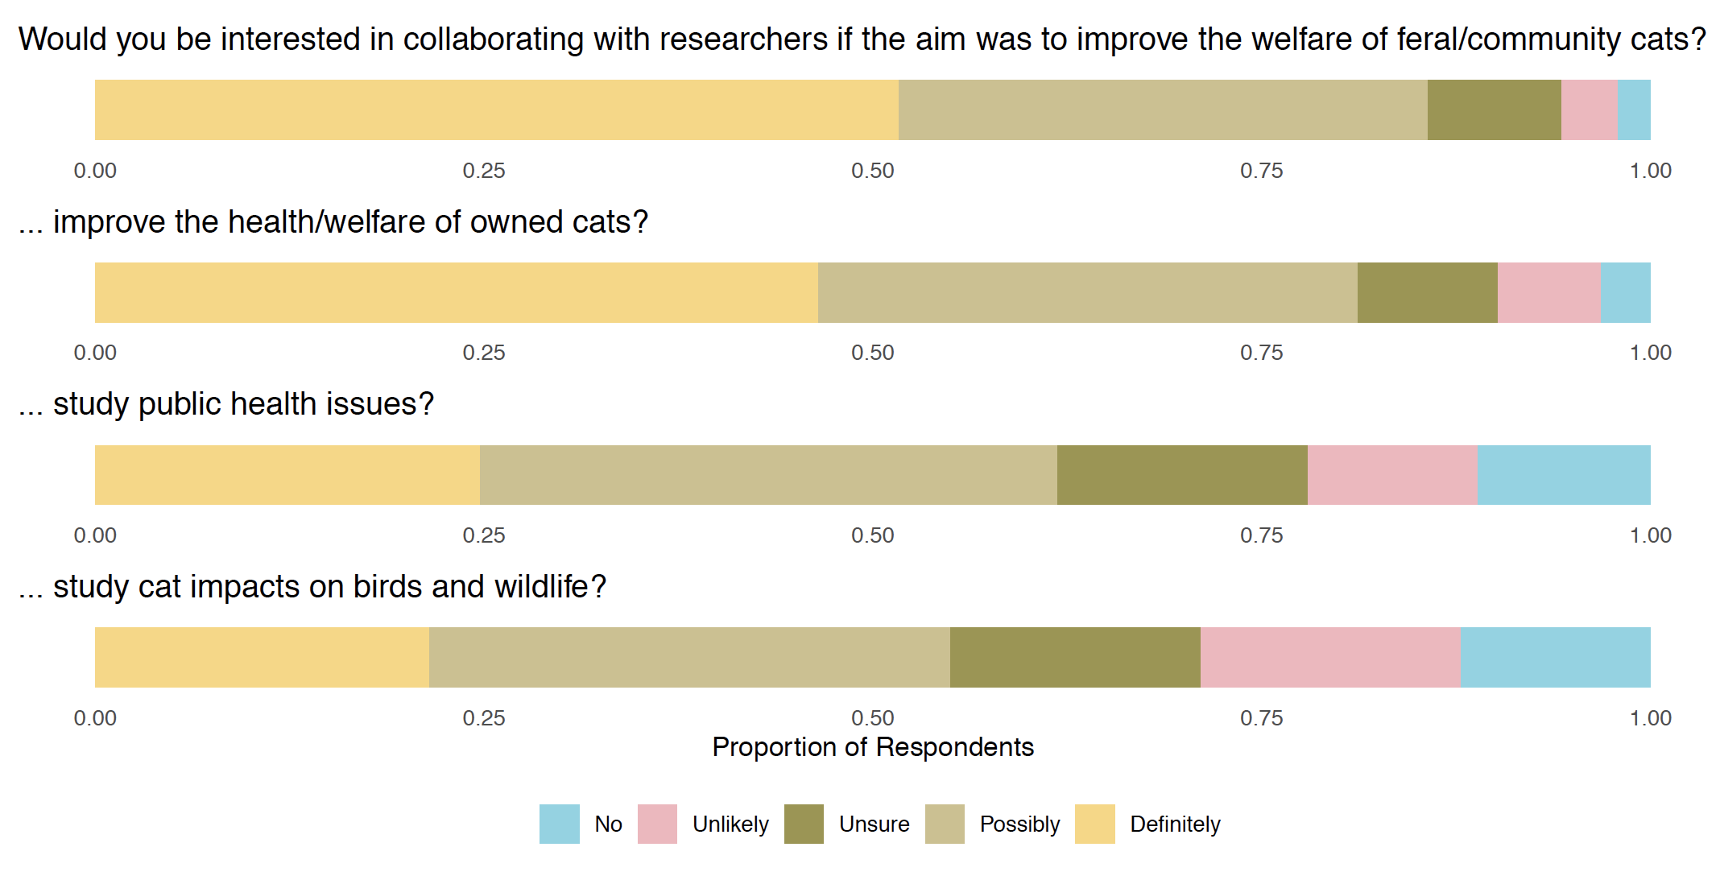
Caption: In an online survey of 567 organizations in the United States that engaged in care or advocacy for feral and community cats, respondents were asked about different types of research on which they might be interested in collaborating with researchers to study. Most respondents were "definitely" or "possibly" interested in research to improve the welfare of feral and community cats, but this interest declined as the research subject drifted from helping cat to investigating negative impacts of cats.
Notes:
This is a stacked bar chart showing the answers for 4 questions with a shared set of answer options, so I wanted to plot them together. I couldn't figure out how to get the sizing right on my first draft, but Aji sent me a bit of code for patchwork to get the bars all equally sized despite some of the individual graphs having no legend and the bottom one having a legend. Thanks, Aji! I just went with a color palette from the Wes Anderson colors package (wesanderson).
library(ggplot2)
library(scales)
library(wesanderson)
willingness_feral <- read.csv("willingness_feral.csv")
willingness_feral$Answer <- droplevels(willingness_feral$Answer)
Answer <- levels(willingness_feral$Answer)
q1 <- ggplot(willingness_feral, aes(y=count, x=factor(group), fill=factor(Answer, levels=c("No", "Unlikely", "Unsure", "Possibly", "Definitely")))) +
geom_bar(position = "fill", stat = "identity") +
ylab("Proportion of Respondents") +
scale_fill_discrete(name="Answer \nChoice") +
ggtitle("Would you be interested in collaborating with researchers if the aim was to improve the welfare of feral/community cats?") +
scale_color_manual("Answer", labels = Answer, guide="legend") +
scale_fill_manual(values=wes_palette(n=5, name="Moonrise3")) +
theme(legend.position="none") +
theme(legend.title = element_blank()) +
theme(axis.title.y = element_blank()) +
theme(axis.title.x = element_blank()) +
theme(legend.key = element_rect(fill = "white"))+
theme(axis.text.y = element_blank()) +
theme(axis.ticks = element_blank()) +
theme(panel.background = element_rect(fill = "#ffffff"),
panel.grid.major = element_line(colour = "#ffffff")) +
coord_flip()
q1
willingness_pet <- read.csv("willingness_pet.csv")
willingness_pet$Answer <- droplevels(willingness_pet$Answer)
Answer <- levels(willingness_pet$Answer)
q2 <- ggplot(willingness_pet, aes(y=count, x=factor(group), fill=factor(Answer, levels=c("No", "Unlikely", "Unsure", "Possibly", "Definitely")))) +
geom_bar(position = "fill", stat = "identity") +
ylab("Proportion of Respondents") +
scale_fill_discrete(name="Answer \nChoice") +
ggtitle("... improve the health/welfare of owned cats?") +
scale_color_manual("Answer", labels = Answer, guide="legend") +
scale_fill_manual(values=wes_palette(n=5, name="Moonrise3")) +
theme(legend.position="none") +
theme(legend.title = element_blank()) +
theme(axis.title.y = element_blank()) +
theme(axis.title.x = element_blank()) +
theme(legend.key = element_rect(fill = "white"))+
theme(axis.text.y = element_blank()) +
theme(axis.ticks = element_blank()) +
theme(panel.background = element_rect(fill = "#ffffff"),
panel.grid.major = element_line(colour = "#ffffff")) +
coord_flip()
q2
willingness_ph.csv <- read.csv("willingness_ph.csv")
willingness_ph.csv$Answer <- droplevels(willingness_ph.csv$Answer)
Answer <- levels(willingness_ph.csv$Answer)
q3 <- ggplot(willingness_ph.csv, aes(y=count, x=factor(group), fill=factor(Answer, levels=c("No", "Unlikely", "Unsure", "Possibly", "Definitely")))) +
geom_bar(position = "fill", stat = "identity") +
ylab("Proportion of Respondents") +
scale_fill_discrete(name="Answer \nChoice") +
ggtitle("... study public health issues?") +
scale_color_manual("Answer", labels = Answer, guide="legend") +
scale_fill_manual(values=wes_palette(n=5, name="Moonrise3")) +
theme(legend.position="none") +
theme(legend.title = element_blank()) +
theme(axis.title.y = element_blank()) +
theme(axis.title.x = element_blank()) +
theme(legend.key = element_rect(fill = "white"))+
theme(axis.text.y = element_blank()) +
theme(axis.ticks = element_blank()) +
theme(panel.background = element_rect(fill = "#ffffff"),
panel.grid.major = element_line(colour = "#ffffff")) +
coord_flip()
q3
willingness_wild.csv <- read.csv("willingness_wild.csv")
willingness_wild.csv$Answer <- droplevels(willingness_wild.csv$Answer)
Answer <- levels(willingness_wild.csv$Answer)
q4 <- ggplot(willingness_wild.csv, aes(y=count, x=factor(group), fill=factor(Answer, levels=c("No", "Unlikely", "Unsure", "Possibly", "Definitely")))) +
geom_bar(position = "fill", stat = "identity") +
ylab("Proportion of Respondents") +
scale_fill_discrete(name="Answer \nChoice") +
ggtitle("... study cat impacts on birds and wildlife?") +
scale_color_manual("Answer", labels = Answer, guide="legend") +
scale_fill_manual(values=wes_palette(n=5, name="Moonrise3")) +
theme(legend.position="bottom") +
theme(legend.title = element_blank()) +
theme(axis.title.y = element_blank()) +
theme(legend.key = element_rect(fill = "white"))+
theme(axis.text.y = element_blank()) +
theme(axis.ticks = element_blank()) +
theme(panel.background = element_rect(fill = "#ffffff"),
panel.grid.major = element_line(colour = "#ffffff")) +
coord_flip()
q4
library(patchwork) #better
(q1)/
(q2)/
(q3)/
(q4) + plot_layout(heights=c(1,1,1,1))

Slide 7
Caption: A summary of the participant demographics in an online survey of 567 organizations in the United States that engaged in care or advocacy for feral and community cats. Top: a map of respondent locations across the country; Bottom, left to right: the number of feral and community cats they serve each year; the organizations number of paid employees; the number of the organization's active volunteers.
Notes:
I started out trying to do these as a 2x2 square, but the map axes weren't aligning well, and Trevor suggested I just put the map above the three donut charts, which makes more sense.
#Basic chloropleth map with shading by state for respondents
library(plyr)
library(dplyr)
library(ggplot2)
library(zipcode)
library(tidyverse)
library(maps)
library(viridis)
library(grid)
library(albersusa)
library(ggthemes)
mapdata <- read.csv("5MewnionFORMAP.csv") #just map data
usa <- usa_sf("aeqd") #state outlines map
mapdata <- left_join(mapdata,usa,by=c("name","name")) #gives error, okay
#count the number of reports by state
reports_per_state <- ddply(mapdata,c("name"),summarize,n=length(name))
#merge the number of reports
states <- left_join(mapdata,reports_per_state,by=c("name"))
mewnionmap <- subset(states)
mewnionmap$n[is.na(mewnionmap$n)] <- 0
#Mewnion plot purple
respondents <- ggplot()+
theme_map(base_size = 11) +
aes(geometry = geometry) +
theme(legend.background = element_blank(),panel.grid.major=element_line(colour = "white")) +
geom_sf(data=mewnionmap,aes(fill=n,color=n) )+
geom_sf(lwd=0.2,col="black",data=usa,fill=NA) +
scale_fill_continuous(low="grey85",high="#330066") +
scale_color_continuous(low="grey85",high="#330066") +
theme(legend.position = "right")
respondents
# Pie charts about organization size
library("ggplot2")
library("dplyr")
mycols <- c("#ff66ff", "#cc00ff", "#9900cc", "#660099", "#330066") #purple and pink
mycols <- c("#eacbf8", "#cc99ff", "#9966cc", "#663399", "#330066") #purple
pie_volunteers <- read.csv("pie_volunteers.csv")
as.data.frame(pie_volunteers)
pie_volunteers <- pie_volunteers %>%
arrange(desc(Answer)) %>%
mutate(lab.ypos = cumsum(prop) - 0.5*prop)
pie_volunteers
pie_vol <- ggplot(pie_volunteers, aes(x = 2, y = prop, fill = Answer)) +
geom_bar(stat = "identity", color = "white") +
coord_polar(theta = "y", start = 0)+
geom_text(aes(y = lab.ypos, label = prop), color = "white")+
scale_fill_manual(values = mycols) +
theme_void()+
xlim(0.5, 2.5)
pie_vol
pie_employees <- read.csv("pie_employees.csv")
as.data.frame(pie_employees)
pie_employees <- pie_employees %>%
arrange(desc(Answer)) %>%
mutate(lab.ypos = cumsum(prop) - 0.5*prop)
pie_employees
pie_emp <- ggplot(pie_employees, aes(x = 2, y = prop, fill = Answer)) +
geom_bar(stat = "identity", color = "white") +
coord_polar(theta = "y", start = 0)+
geom_text(aes(y = lab.ypos, label = prop), color = "white")+
scale_fill_manual(values = mycols) +
theme_void()+
xlim(0.5, 2.5)
pie_emp
pie_ferals <- read.csv("pie_ferals.csv")
as.data.frame(pie_ferals)
pie_ferals <- pie_ferals %>%
arrange(desc(Answer)) %>%
mutate(lab.ypos = cumsum(prop) - 0.5*prop)
pie_ferals
pie_fer <- ggplot(pie_ferals, aes(x = 2, y = prop, fill = Answer)) +
geom_bar(stat = "identity", color = "white") +
coord_polar(theta = "y", start = 0)+
geom_text(aes(y = lab.ypos, label = prop), color = "white")+
scale_fill_manual(values = mycols) +
theme_void()+
xlim(0.5, 2.5)
pie_fer
# Putting it all together
library(patchwork)
(respondents)/
(pie_fer+pie_emp+pie_vol) + plot_layout(heights=c(4,1.5,1.5,1.5))
#then fix legend location in Photoshop
ggsave('demog2.pdf', width=20, height=16)

Slide 8
Rosheen Birdie

Slide 9
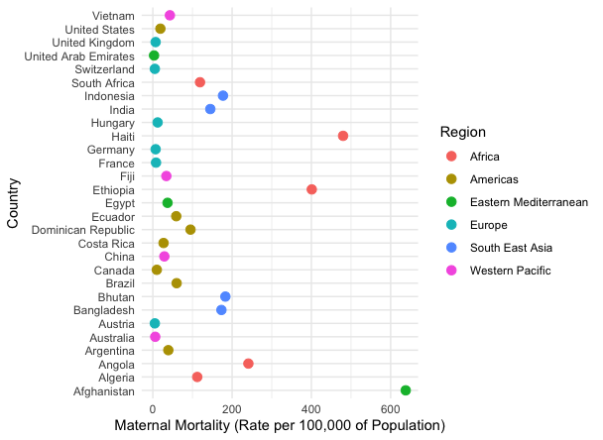
World Health Organization – Maternal Mortality Rate for Select Countries in 2017
Fig.1 This figure depicts the maternal mortality rate per 100,000 of the population for 29 countries in 2017.

Slide 10
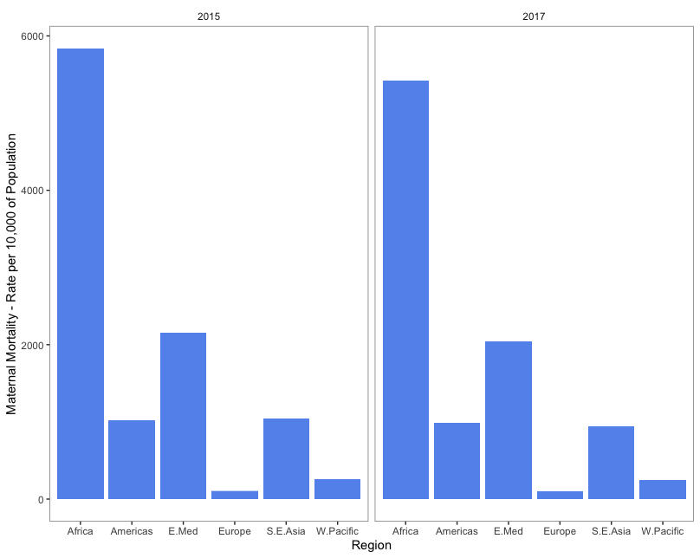
World Health Organization – Maternal Mortality Rate across WHO regions in 2017
Fig. 2 This figure depicts the maternal mortality rate per 10,000 of the population in 2017 across the six WHO regions

Slide 11
Bryan Antonio Briones Ortiz

Slide 12
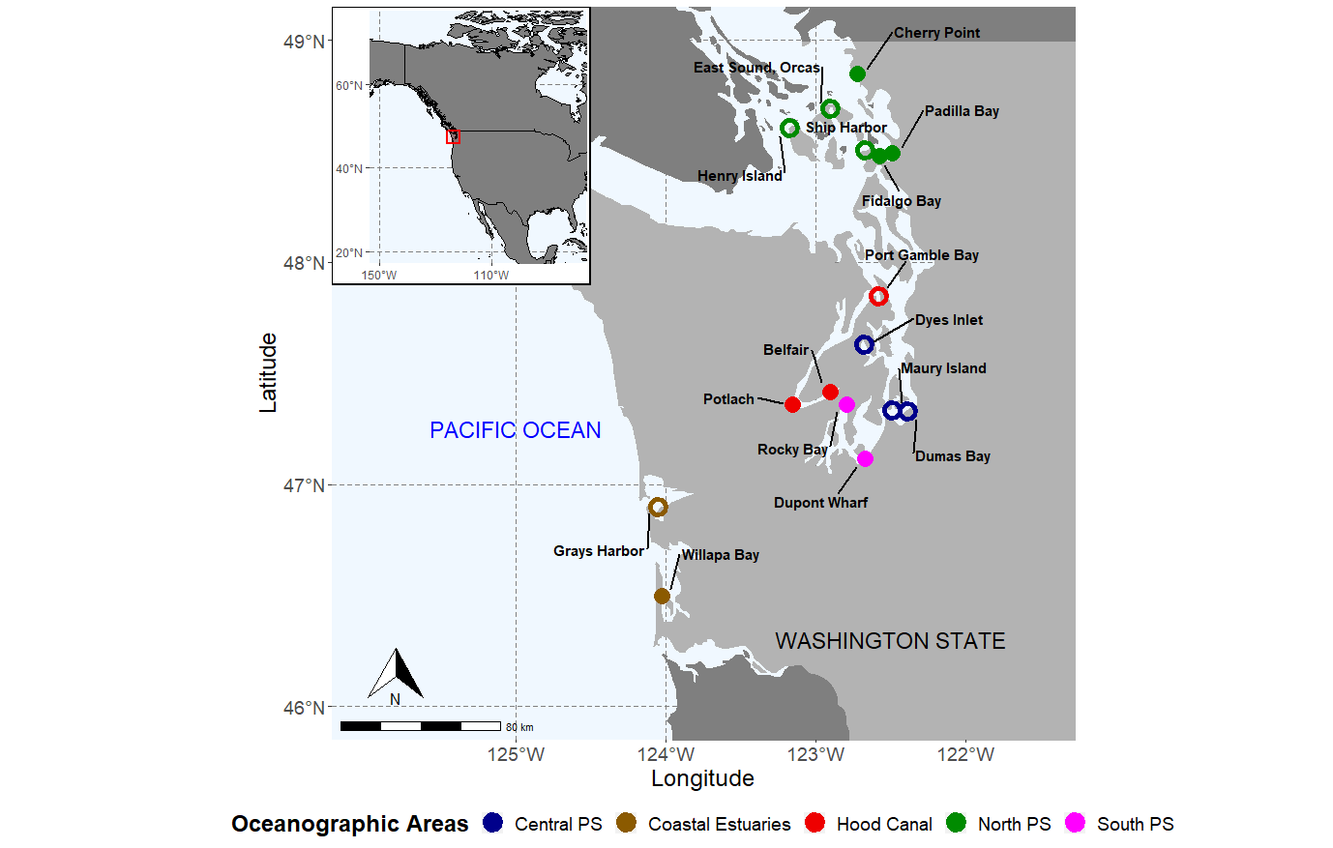
Bryan Briones Ortiz
Figure 1. Eelgrass Collection Sites for Population Genetic Analyses in North America (inset). The 16 selected sites represent the breadth of distribution of Zostera marina throuhgout the major oceanographic regions in Washington State (PS = Puget Sound). Filled circles indicate the presence of AnEmOnE monitoring stations that provide complementary environmental data.
Notes:
m1 <- ggplot() +
geom_polygon(data = world_map, aes(x = long, y = lat, group = group), fill = "gray50", size = 0.2)+
geom_polygon(data = wa_map[1294,], aes(x = long, y = lat, group =group), fill = "gray70" )+
coord_sf(xlim = c(- 126, - 121.5), ylim = c(46, 49), crs = "+proj=longlat +datum=WGS84 +no_defs +ellps=WGS84 +towgs84=0,0,0 " )+
labs(x = "Longitude", y = "Latitude") +
geom_point(data = data_df, aes(x = Lat, y = Lon, color = Area, shape = Anemone), size = 4, stroke = 3)+
geom_text_repel(data = data_df, aes(x = Lat, y = Lon,label = Site), segment.size = 1,fontface = "bold", box.padding = 1, segment.color = "black", size = 4, point.padding = 1, color = "black" ) +
scale_shape_manual(values=c(1, 16), guide =FALSE)+
scale_color_manual(values=c('blue4','orange4','red2','green4','magenta'))+
annotate(geom = "text", x = -122.5, y = 46.3, label = "WASHINGTON STATE", color = "black", size = 6)+
annotate(geom = "text", x = -125, y = 47.25, label = "PACIFIC OCEAN", color = "blue", size = 6) +
theme(text = element_text(size=18), legend.title = element_text(face="bold"), legend.position="bottom", panel.grid.minor = element_line(NULL), panel.grid.major = element_line(color = gray(.5), linetype = "dashed", size = 0.5), panel.background = element_rect(fill = "aliceblue")) +
draw_image(image='arrow.png', x=0.2, y=0.1, width=0.4, height=0.4)+
annotation_north_arrow(which_north = "true", pad_y = unit(1,"cm"), pad_x = unit(1,"cm") ) +
annotation_scale()+
labs(color = "Oceanographic Areas") +
scale_x_continuous(breaks=c(-125,-124,-123,-122), labels=paste0(c(125,124,123,122),'°W')) +
scale_y_continuous(breaks=seq(46,49,1), labels=paste0(seq(46,49,1),'°N’))
m2 <- ggplot() +
coord_sf(xlim = c(- 150, - 80), ylim = c(20, 75), crs = "+proj=longlat +datum=WGS84 +no_defs +ellps=WGS84 +towgs84=0,0,0 " )+
geom_polygon(data = america, aes(x = long, y = lat, group = group), fill = "gray50", color = "black") +
geom_polygon(data = p_df, aes(x = long, y = lat, group = group), fill = "red", colour = "red", alpha =0.1, size = 1)+
theme(axis.title.x=element_blank(), axis.title.y=element_blank(), plot.margin = margin(0.1, 0.1, 0.1, 0.1, "cm"), plot.background = element_rect( colour = "black", size = 1 ),
panel.grid.major = element_line(color = gray(.5), linetype = "dashed", size = 0.5), panel.background = element_rect(fill = "aliceblue"))+
scale_x_continuous(breaks=c(-150,-110), labels = paste0(c(150, 110), '°W')) +
scale_y_continuous(breaks=c(20,40,60), labels = paste0(c(20, 40, 60), '°N’))
m1 + annotation_custom(ggplotGrob(m2), xmin = -Inf, xmax = -124.5, ymax = Inf, ymin = 47.9 )

Slide 13
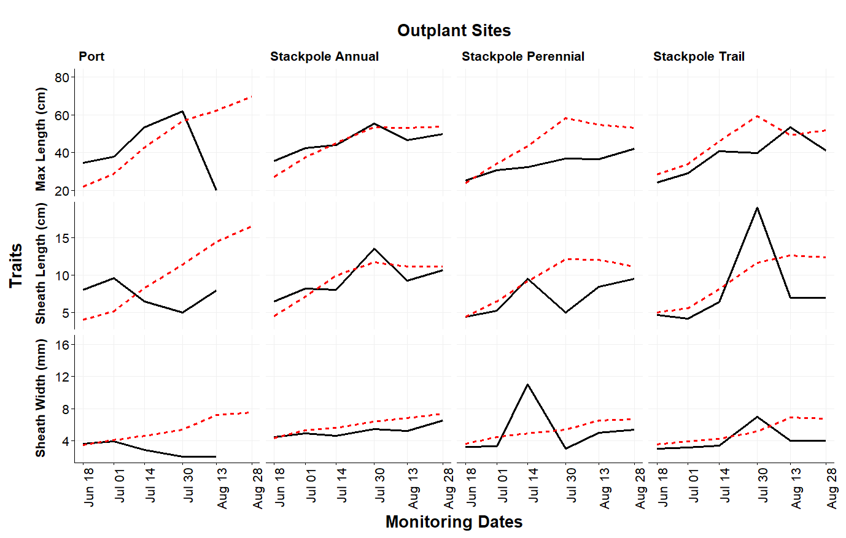
Bryan Briones Ortiz
Figure 2. Change in Key Traits of Translocated Eelgrass with Different Reproductive Strategies in Willapa Bay, WA. Transplantation was carried out in the summer of 2019. Dashed red lines represent annual (sexual) sources, and solid black lines represent perennial (clonal) sources.
Notes:
ggplot(density_long, aes(Date, Value, colour = Source)) +
geom_path(stat = "summary", aes(linetype = Source), size = 1.4) +
scale_color_manual(values=c('black','red'))+
facet_grid(Variable~Outplant_Site, scales = "free_y", switch="y") +
xlab("Monitoring Dates") +
ylab("Traits") +
theme_Publication() +
theme(text = element_text(size=20), strip.placement = "outside",
strip.text.x = element_text(hjust = 0), strip.text.y = element_text(vjust = 1, hjust = 0),
strip.background = element_rect(color = NA, fill = NA), axis.text.x = element_text(angle = 90, hjust = 1),
legend.position = "none", plot.title = element_text(size = 20)) +
scale_x_date(breaks = as.Date(c("0000-06-18", "0000-07-01", "0000-07-14", "0000-07-30", "0000-08-13", "0000-08-28" )),
labels = c("Jun 18", "Jul 01", "Jul 14", "Jul 30", "Aug 13", "Aug 28")) +
labs(title = "Transplant Sites")

Slide 14
Jordan Claytor

Slide 15
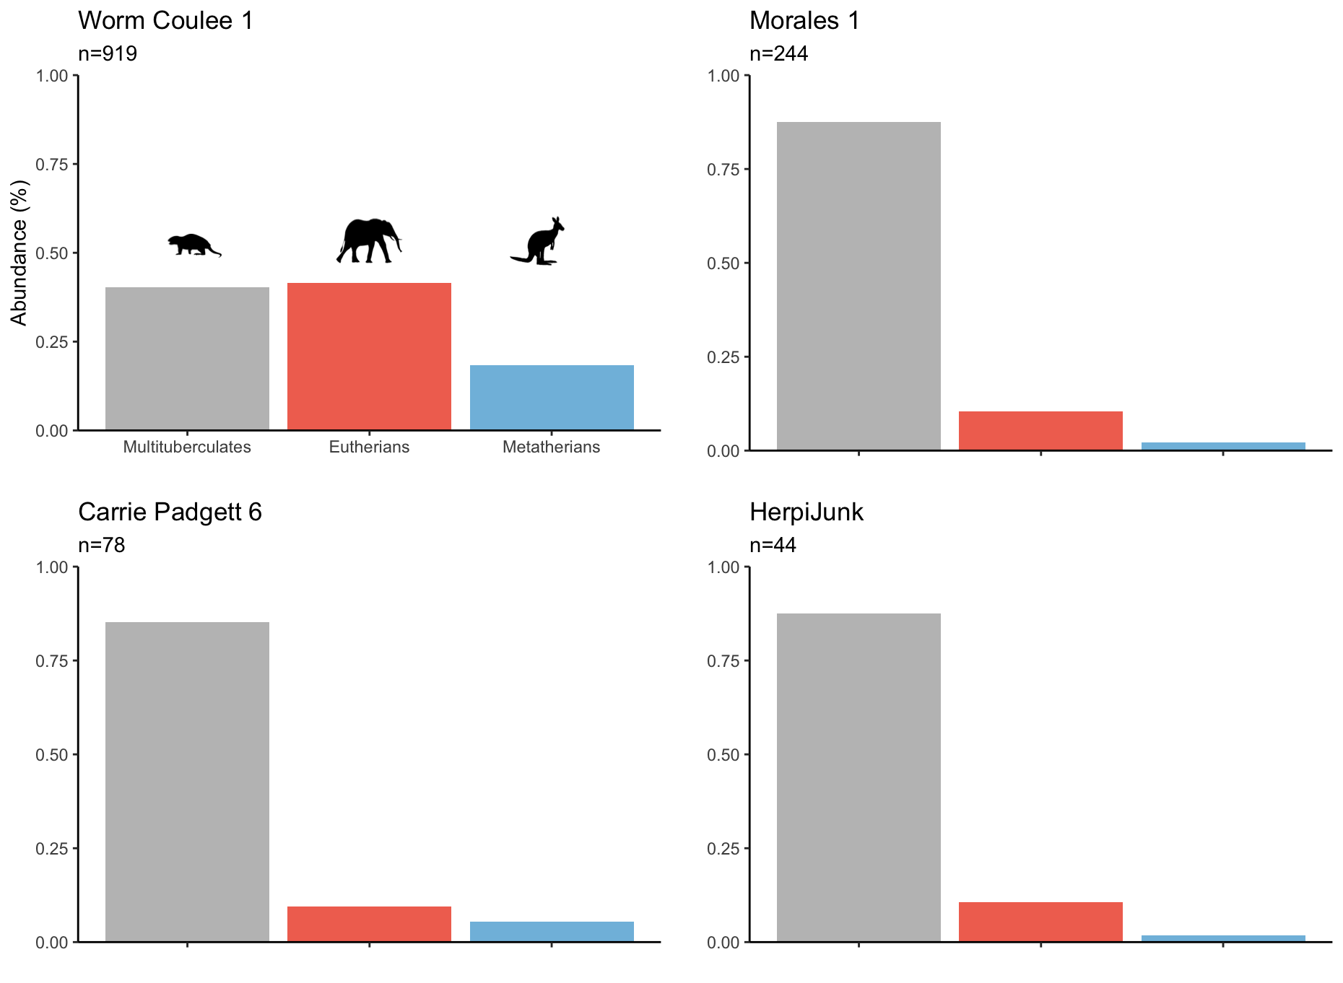
Figure 1: Comparison of the abundance of major mammal clades in four post Cretaceous-Paleogene mass extinction (K-Pg hereby) event localities. Worm Coulee 1 represents the historically most well sampled locality (n=919). Morales 1, HerpiJunk, and Carrie Padgett 6 represent recent collecting efforts (n=244, 44, and 78 respectively). The animal silhouettes correspond to their respective groups.
Notes:
For this figure I used the skills we learned for plotting grids and inserting images into the text. The colors were chosen to highlight the lower abundance clades (eutherians and metatherians) so they stand out against the grey highly abundant multituberculates. Furthermore, the colors are ones I’ve tested to be colorblind safe. I also tried to incorporate the principles of avoiding redundancies and unnecessary ink by removing unnecessary captions and labels.
Here is the code:
Figure_1T<- as_tibble(Figure_1)
View(Figure_1T)
###reorder taxa by abundance###
Figure_1T$Taxa = factor(Figure_1T$Taxa, levels =c("Multituberculates","Eutherians", "Metatherians"))
HJ<-ggplot(data=Figure_1T, aes(x=Taxa, y=HerpiJunk, fill=Taxa)) +
geom_col()+
scale_fill_manual(values=c("#BFBFBF","#F1725F", "#80BDDF"))+
xlab("") +
ylab("") +
labs(subtitle="n=44")+
ggtitle("HerpiJunk") +
scale_y_continuous(limits = c(0,1), expand = c(0,0)) +
theme_classic()+
theme(legend.position='none', axis.text.x=element_blank())
M1<-ggplot(data=Figure_1T, aes(x=Taxa, y=Morales1, fill=Taxa)) +
geom_col()+
scale_fill_manual(values=c("#BFBFBF","#F1725F", "#80BDDF"))+
xlab("") +
ylab("") +
labs(subtitle="n=244")+
ggtitle("Morales 1") +
scale_y_continuous(limits = c(0,1), expand = c(0,0)) +
theme_classic()+
theme(legend.position='none', axis.text.x=element_blank())
WC1<-ggplot(data=Figure_1T, aes(x=Taxa, y=WormCoulee1, fill=Taxa)) +
geom_col()+
scale_fill_manual(values=c("#BFBFBF","#F1725F", "#80BDDF"))+
xlab("")+
ylab("Abundance (%)") +
labs(subtitle="n=919")+
ggtitle("Worm Coulee 1") +
scale_y_continuous(limits = c(0,1), expand = c(0,0)) +
theme_classic()+
theme(legend.position='none')
WC1.E<-ggdraw(WC1) +
draw_image(image="Multi.png", x = 0.25, y = 0.46, width = 0.08, height =0.08)
WC1.EK<-ggdraw(WC1.E)+
draw_image(image="Elephant.png", x = 0.50, y = 0.46, width = 0.1, height =0.1)
WC1.Final<-ggdraw(WC1.EK)+
draw_image(image="Kangaroo.png", x = 0.75, y = 0.46, width = 0.1, height =0.1)
CP<-ggplot(data=Figure_1T, aes(x=Taxa, y=CarriePadgett6, fill=Taxa)) +
geom_col()+
scale_fill_manual(values=c("#BFBFBF","#F1725F", "#80BDDF"))+
xlab("") +
ylab("") +
labs(subtitle="n=78")+
ggtitle("Carrie Padgett 6") +
scale_y_continuous(limits = c(0,1), expand = c(0,0)) +
theme_classic()+
theme(legend.position='none', axis.text.x=element_blank())
plot_grid(WC1.Final, M1, CP, HJ,
label_size = 12,
align= c("t", "b"),
nrow = 2,
ncol = 2)

Slide 16
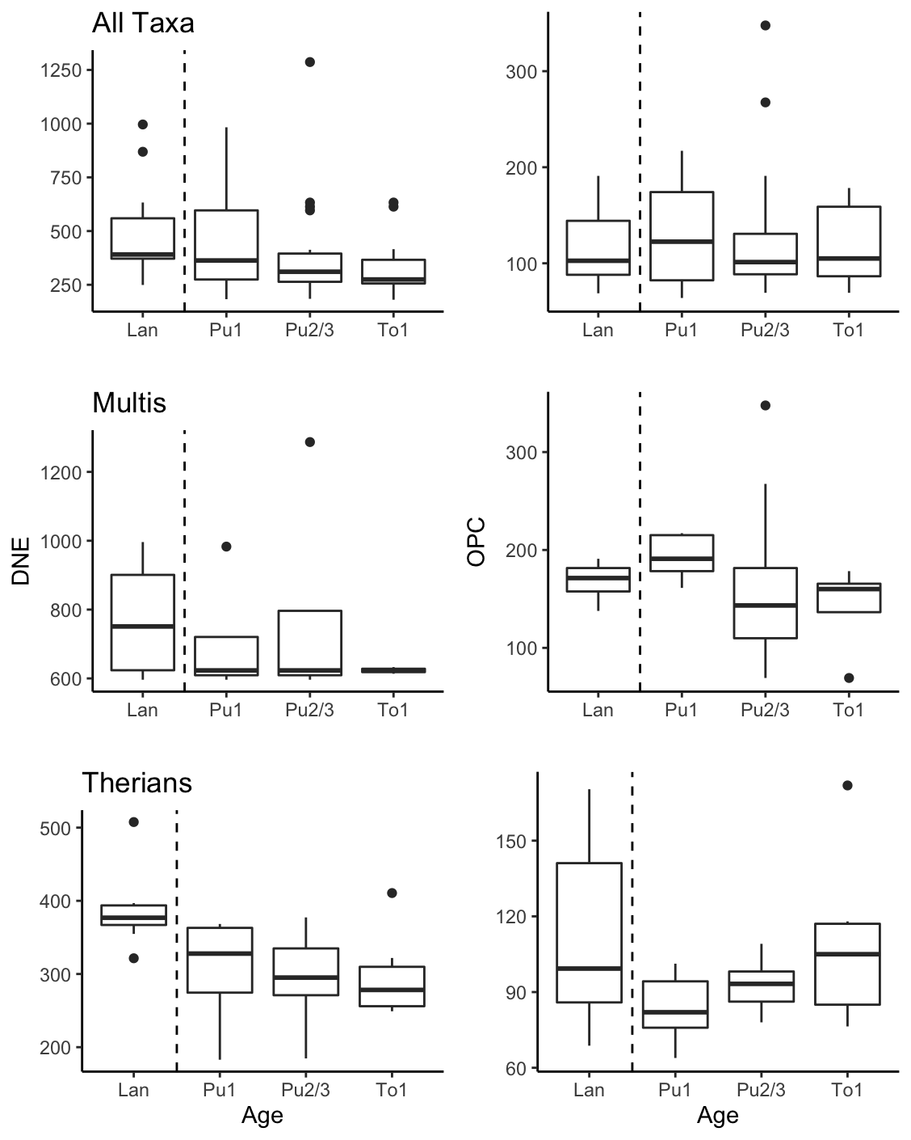
Figure 2: OPC and DNE are metrics using a tooth’s overall shape and morphology to make inference on a mammal’s dietary ecology. Lower DNE values and higher OPC values typically indicate a more herbivorous diet, while the opposite indicates a more faunivorous diet. Here we track DNE and OPC values for all mammals across the K-Pg boundary to investigate potential changes in diet. The top row includes all mammal, the middle is only the multituberculates (a now extinct group of mammals) and the bottom is only the therians (placentals and marsupials). The dotted line illustrates the K-Pg boundary line.
Notes:
For this figure I wanted to focus on simplicity. I used the principles of avoiding redundancy and excess ink usage when choosing how to display the labels for each graph. Like the first I used the plotgrid skills to create a composite of all the different groups. I also added the dotted line to symbolize an important marker in the data (a mass extinction).
Here is the code:
Figure_3DaTa<- as_tibble(Figure_3)
View(Figure_3DaTa)
AllTaxaDNE<-ggplot(data=Figure_3DaTa, aes(x=Age, y=DNE))+
geom_boxplot()+
ggtitle("All Taxa")+
xlab("")+
ylab("")+
geom_vline(xintercept=1.5, linetype="dashed")+
theme_classic()
AllTaxaOPC<-ggplot(data=Figure_3DaTa, aes(x=Age, y=OPC))+
geom_boxplot()+
xlab("")+
ylab("")+
geom_vline(xintercept=1.5, linetype="dashed")+
theme_classic()
All<-plot_grid(AllTaxaDNE, AllTaxaOPC, ncol=2, align="v")
#####Minus Multis####
Figure_3Therians<-filter(Figure_3DaTa, Clade == c("Meta", "Eu"))
TherianDNE<-ggplot(data=Figure_3Therians, aes(x=Age, y=DNE))+
geom_boxplot()+
ggtitle("Therians")+
ylab("")+
geom_vline(xintercept=1.5, linetype="dashed")+
theme_classic()
TherianOPC<-ggplot(data=Figure_3Therians, aes(x=Age, y=OPC))+
geom_boxplot()+
ylab("")+
geom_vline(xintercept=1.5, linetype="dashed")+
theme_classic()
Therian<-plot_grid(TherianDNE, TherianOPC, ncol=2, align="v")
#####Only Multis########
Figure_3Multis<-filter(Figure_3DaTa, Clade == c("Multi"))
MultiDNE<-ggplot(data=Figure_3Multis, aes(x=Age, y=DNE))+
geom_boxplot()+
ggtitle("Multis")+
xlab("")+
geom_vline(xintercept=1.5, linetype="dashed")+
theme_classic()
MultiOPC<-ggplot(data=Figure_3Multis, aes(x=Age, y=OPC))+
geom_boxplot()+
xlab("")+
geom_vline(xintercept=1.5, linetype="dashed")+
theme_classic()
Multi<-plot_grid(MultiDNE, MultiOPC, ncol=2, align="v")
plot_grid(All,Multi,Therian, nrow=3)

Slide 17
Chris Dailey

Slide 18
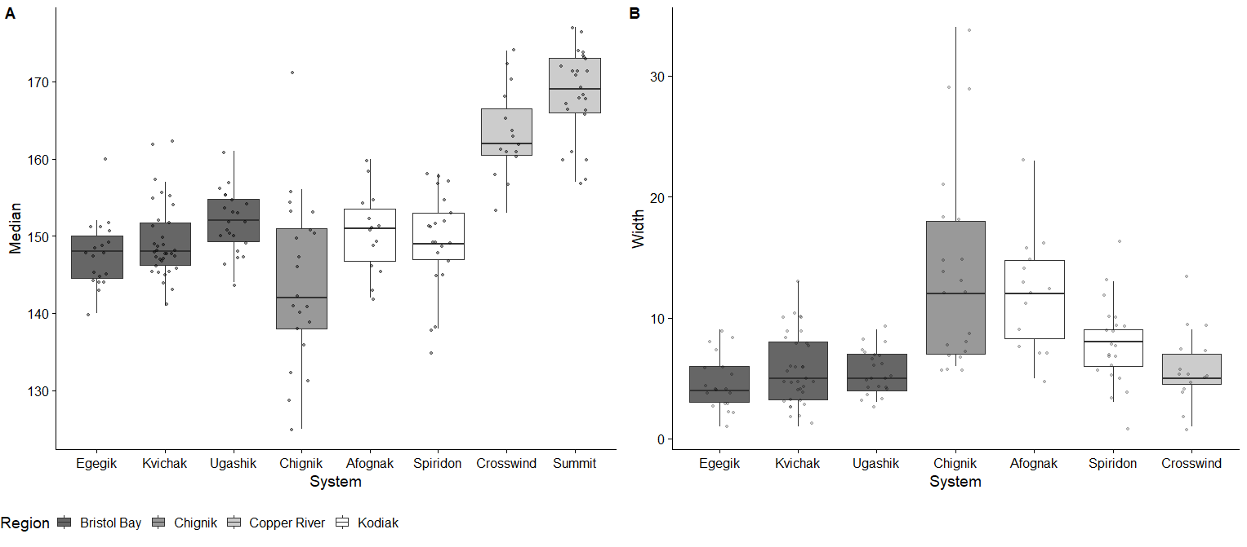
Notes:
Figure: (A) Summary of median sockeye salmon smolt emigration timing (DOY50), by study site, for populations in Bristol Bay, Kodiak Island, the Copper River, and Chignik, Alaska. (B) Summary of width of smolt emigration period (defined as DOY25-DOY75) by study site.

Slide 19
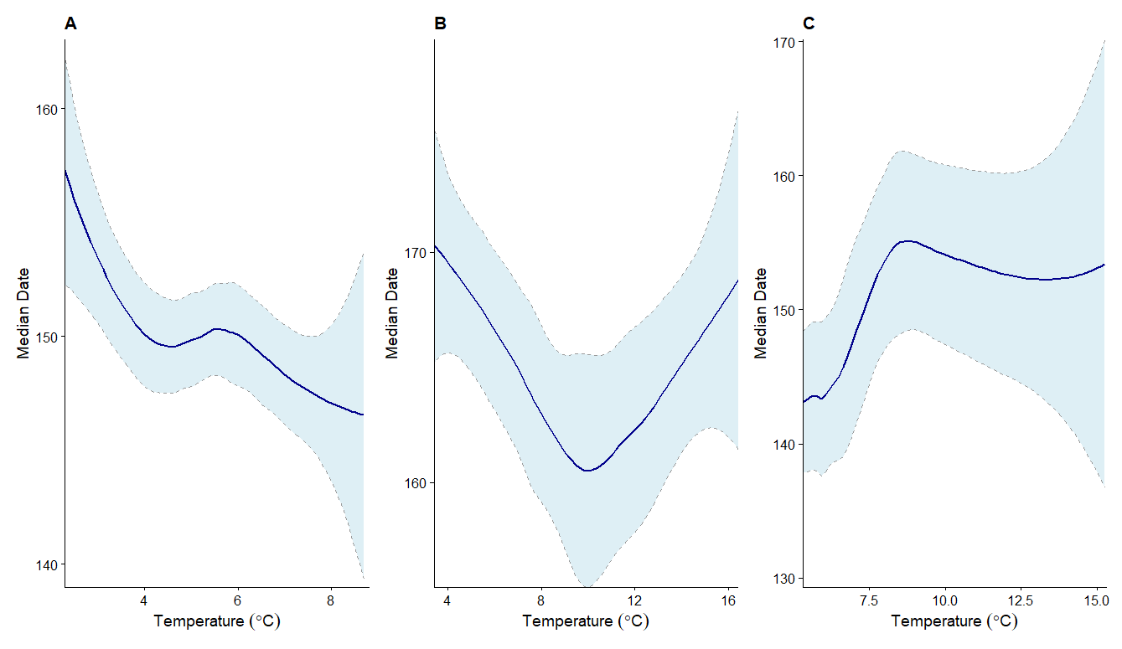
Notes:
Relationship of freshwater temperature to timing of peak sockeye salmon smolt emigration day (DOY50) for populations in Bristol Bay (A), the Copper River (B), and Kodiak Island and Chignik (C)

Slide 20
Lou Forristall

Slide 21
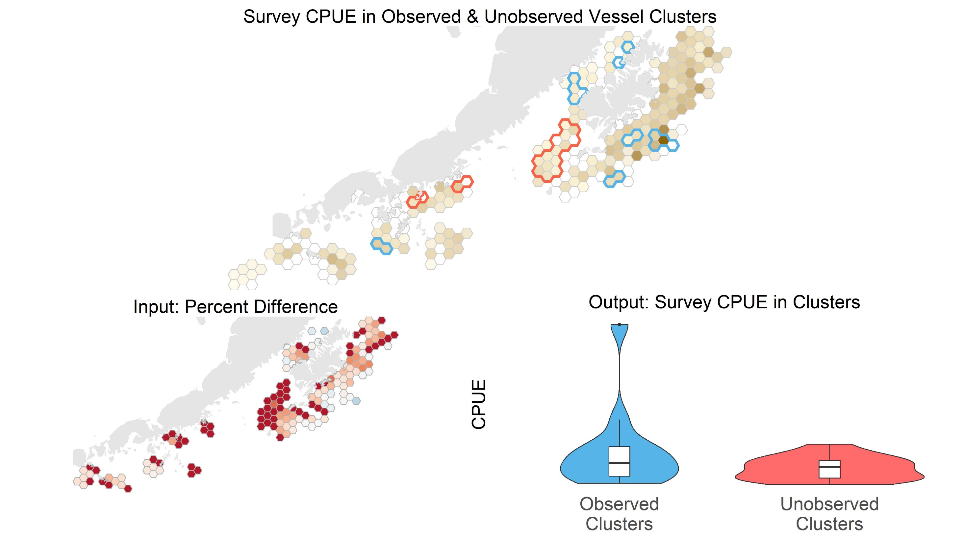
Notes:
This is a multipanel plot meant to show the research process for my capstone project. The top figure is showing clusters of observed (blue) and unobserved (red) groundfish bottom trawl vessels in the Gulf of Alaska with the International Pacific Halibut Commissions Setline Survey Catch Per Unit Effort (CPUE) as the fill in the grid cells.
The bottom left figure, labelled input, shows the input variable used to determine clusters. The variable that fills the grid cells is the percent difference between observed and unobserved distinct vessels in each grid cell, i.e. (observed – unobserved)/total vessels. Blue cells show the areas where there were more observed vessels, red cells show where there are more unobserved vessels, and white cells show where they are about equal.
The bottom right figure shows the important result from the top map: the survey CPUE’s in the different groups of identified clusters of grid cells. The survey CPUEs within each cluster were used in permutation test. They did not have a statistically significant difference. The box and violin plots are meant to show how similar the CPUEs are from the above map, with the exception of one high outlier in the Observed Clusters group.
This last takeaway was important for the capstone project, where we were trying to determine if there was an observer effect in this fleet (shown by the presence of statistically significant clusters) and if was driven by incentives to avoid areas of high halibut abundance when fishers are observed (comparison of the means).
I used the patchwork package to arrange these plots. Finding the right layout took some trial and error. I wanted the top map to be largest, but all plots to have enough room to be read. I ended up with this layout:
“AAAA
AAAA
BBCC”
Which worked well. I used advice from the peer reviews to eliminate an additional plot, simplify the top map, adjust the fill color in the top map, and zoom in closer on the maps.

Slide 22
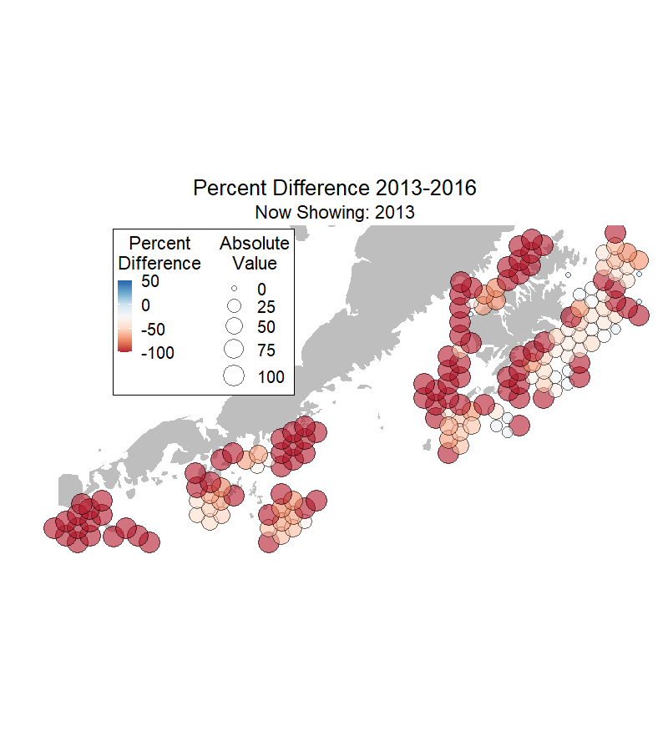
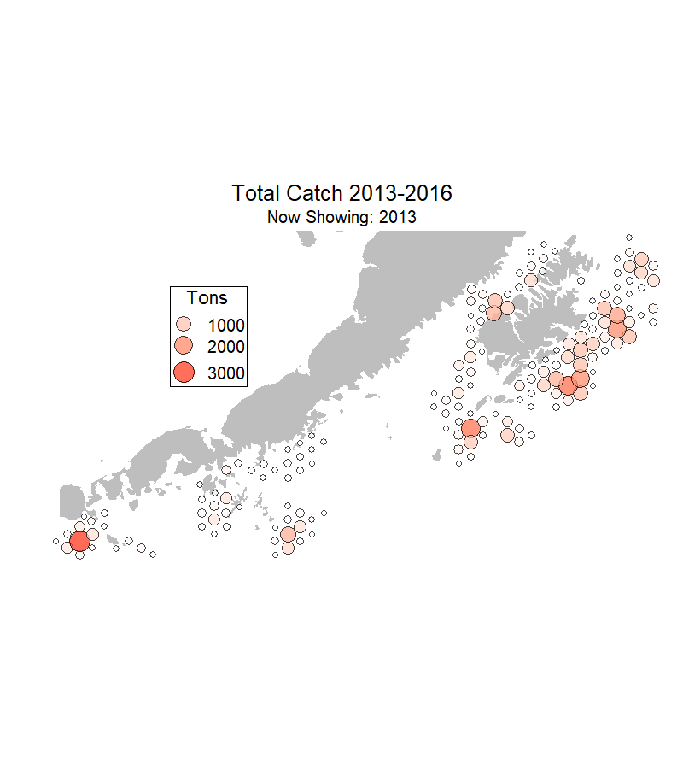
Notes:
This two separate figures that I put together here for the purposes of understanding them. The left figure is what I submitted for peer review previously. A secondary question for the capstone project was if estimates of catch were based off small amounts of observer data based on location. The left map shows the percent difference variable discussed on the previous slide for 2013-16. The right shows total catch (observed retained and discarded catch + unobserved retained and discarded catch) for the same points. Both maps are animated gifs.
Focus should be directed to the right side of each map, below Kodiak island (the large island on the right side of the map). This area is where observer coverage tends to be best across all years (blue and white points) and where catch is also highest. These maps are meant to illustrate the conclusion that catch estimates are strong for the more part, since the areas of highest catch are also the areas that are most observed.
I used the gganimate package to create the gifs. I found it relatively easy to use. It creates the gifs in a way similar to facet_wrap, where you designate a variable as a “transition state” instead of using facet_wrap(~variable). I could not properly use this package before this course. Then you can customize the animation effects and timing.
I used feedback on these plots to again zoom in, adjust the transition timing and length, change the background color and change the point character to 21 so that you could see an outline of points.

Slide 23

Seattle Public Graduation Rate 2015-19
Lamar Foster
FISH 554

Slide 24
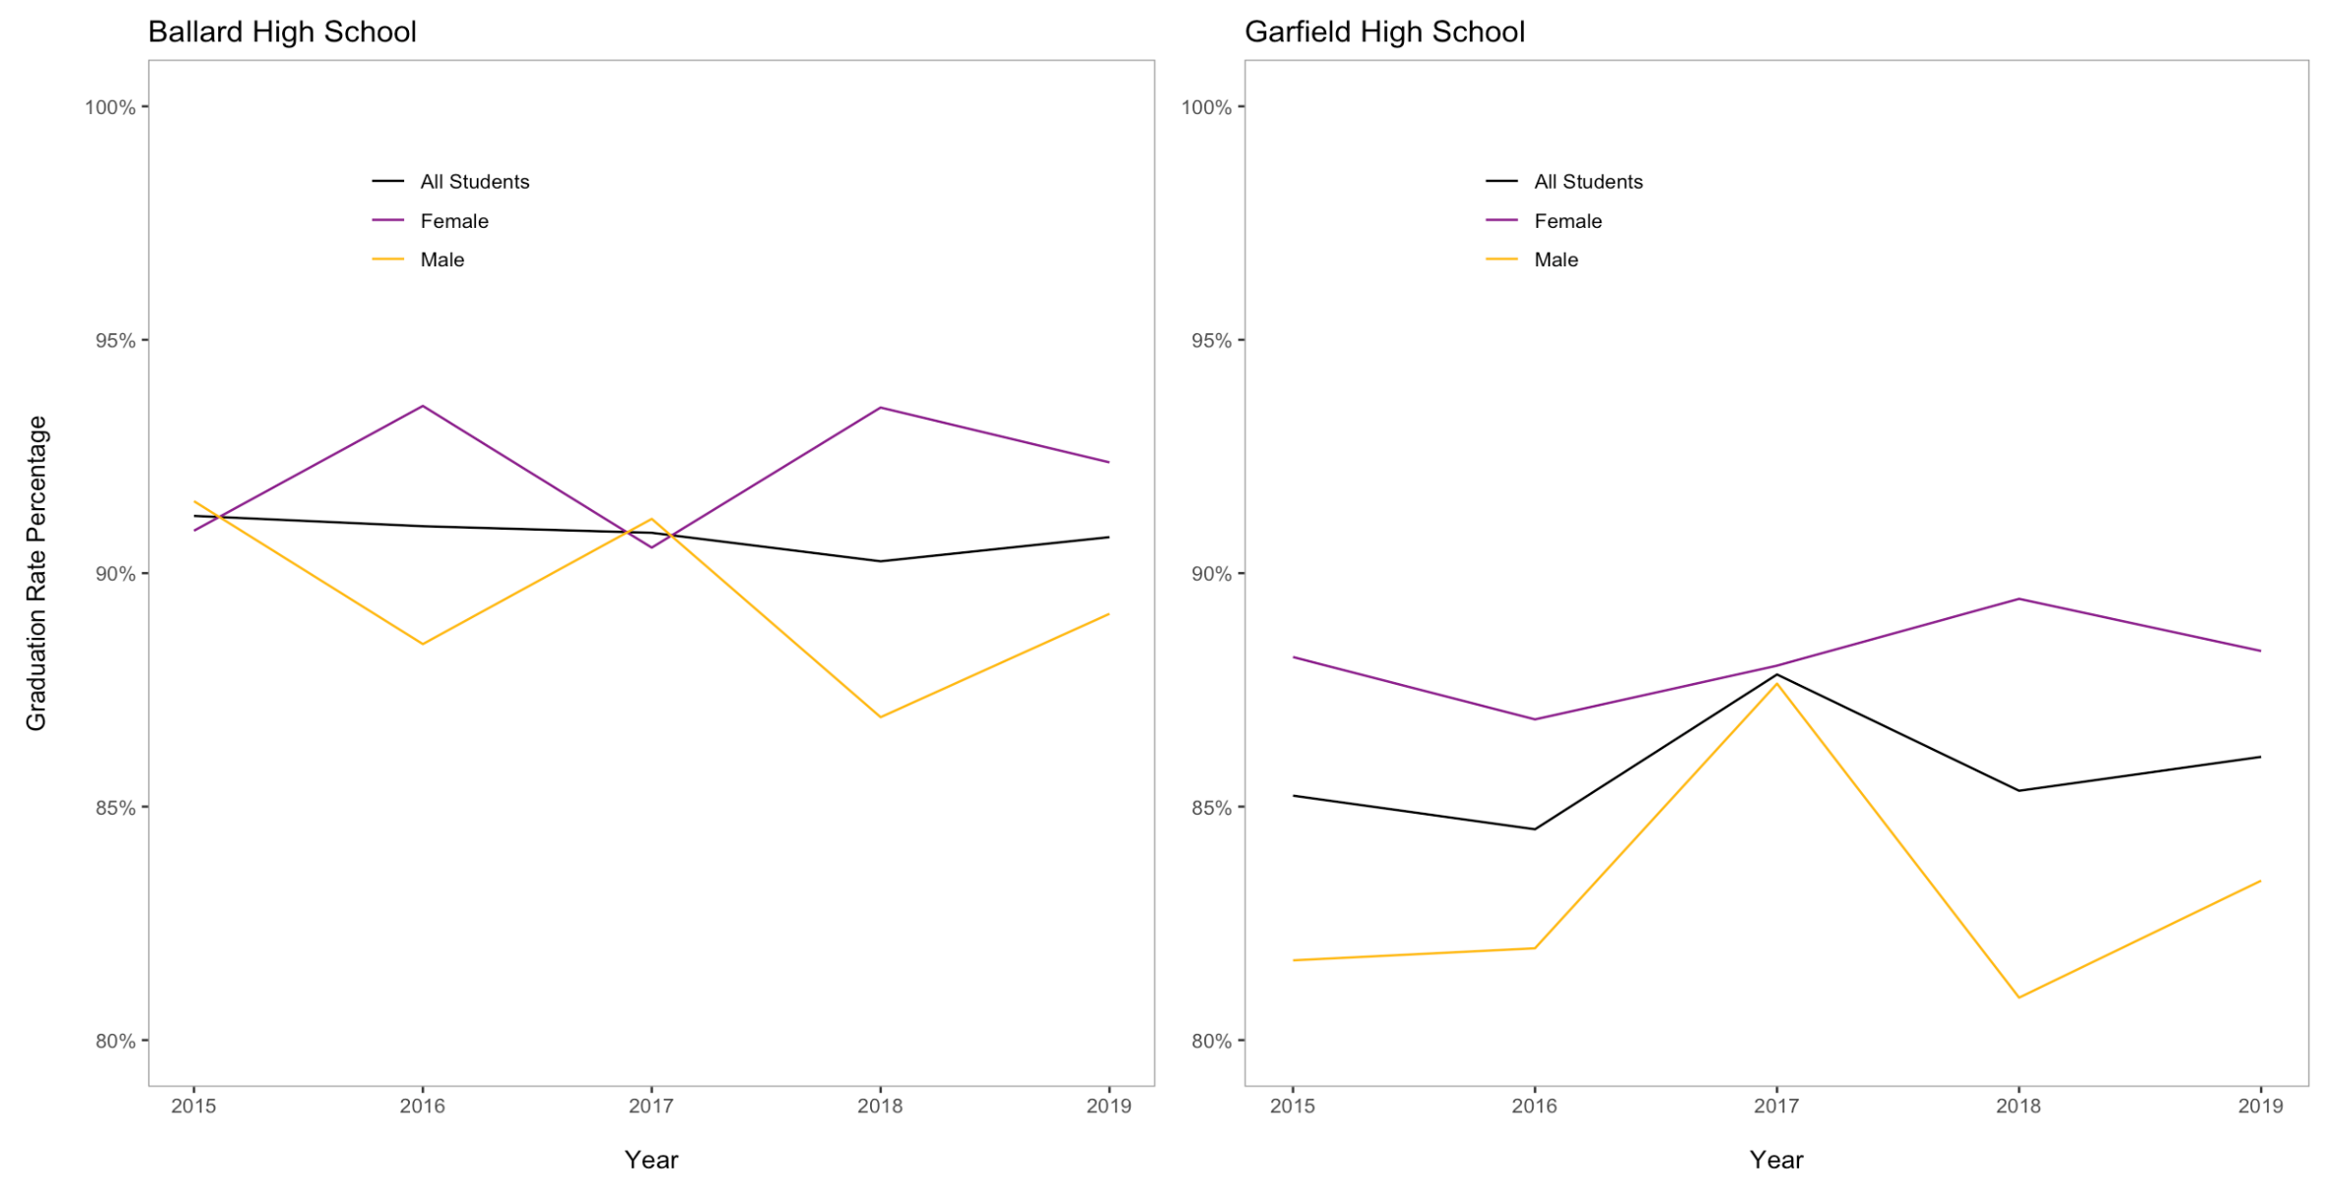
Notes:
A technique I learned in this class that I used to produce this plot is cowplot, positioning the legend, and using themes to format the background.

Slide 25
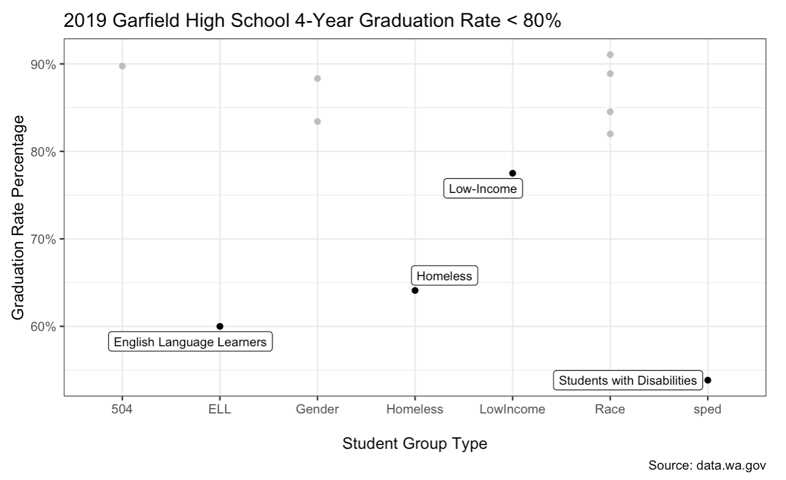
Notes:
I employed gghighlight and scale_y_continuous perecent (two things I learned from this class). Below is my code, for those interested.
ggplot(data=Garfield_Slim4, aes(x=StudentGroupType, y=GraduationRate)) + geom_point() + theme_bw() + labs(title= "2019 Garfield High School 4-Year Graduation Rate < 80%", x = "\nStudent Group Type", y = "Graduation Rate Percentage", caption = "Source: data.wa.gov") + gghighlight(GraduationRate < .80, label_key = StudentGroup, label_params = list(size = 3), unhighlighted_colour = "grey") + scale_y_continuous(labels = percent)

Slide 26
Vivian Griffey

Slide 27
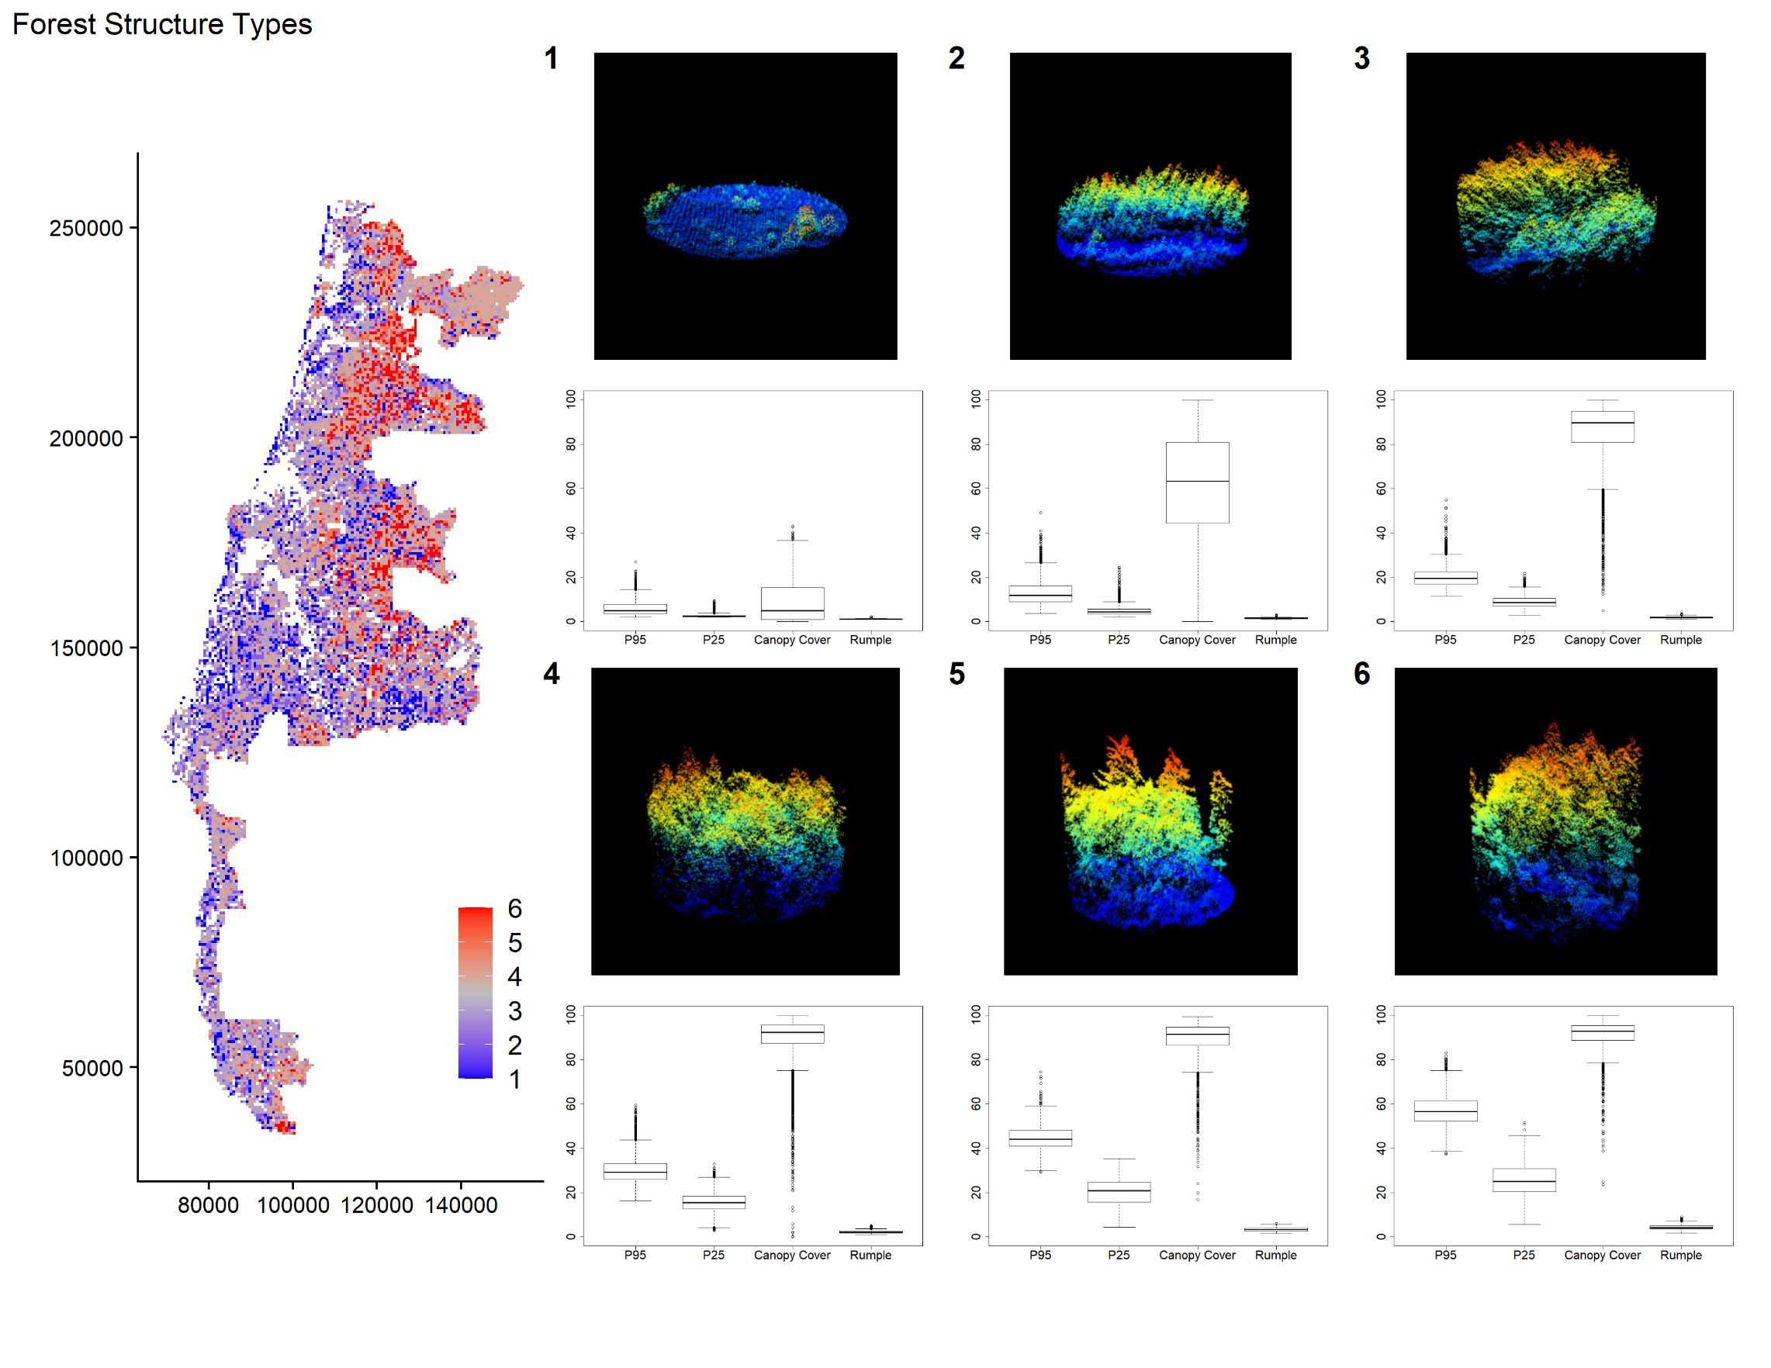
Figure 1:
This figure shows different ways to understand the six different types of forest structure in my study area. First, a map of the distribution of structure types across the study area. Then, for each structure type, representative samples from lidar point clouds and boxplots showing the distribution of different lidar descriptors.
Notes:
This is largely an effort of combining different types of plots into one using patchwork. I brought in the point cloud snapshots as well as the base r boxplots as images like so
p1 =ggdraw() +
draw_plot(p)+
draw_image(trim1) +
labs(tag = "1")
Where p is a blank ggplot I initiated and trim1 is the name of one of the point cloud images.
The map was done using
map = gplot(sc) +
geom_tile(aes(fill = value))
Deliberatly “gplot” instead of ggplot. SC is a raster I loaded in, and then geom_tile takes the values of that raster as the fill
Then, I built a layout (“design”, below) and set up my figure using patchwork
design <- "
1234
1234
1567
1567
"
map + (p1/p1_bplot) + (p2/p2_bplot) + (p3/p3_bplot)+ (p4/p4_bplot) +
(p5/p5_bplot) + (p6/p6_bplot)+
plot_layout(design = design)+ plot_annotation(title="Forest Structure Types")

Slide 28
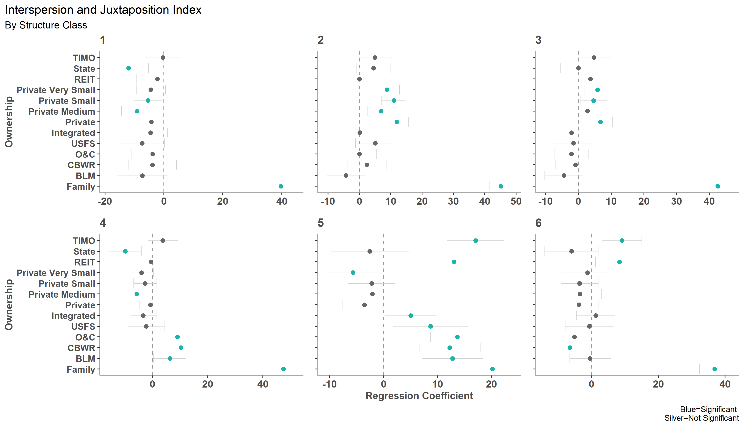
Figure 2:
This figure shows the regression coefficients of a linear model of different land ownerships, size of those land ownerships, and proportion of forest structure class. There are 6 different forest structure types, representing different forest developmental stages. With the linear model, we wanted to see how land ownership affected forest structure (here, measured as interspersion and juxtaposition index).
Notes:
I used the package ggstatsplot and the function ggcoefstats to make the individual subplots here. Then I put them together using patchwork. I was particularly excited to differentiate the point color by significance, using an ifelse statement to assign colors to a new column in the data frame.
Any help on how to edit the font so it will be plain instead of bold would be great. I’ve figured out how to edit everything I need to within ggcoefstats except for that.
test <- ggcoefstats(iji6, "tidy", exclude.intercept = F)
test <- filter(test, term!="X6" & term!="Shape_Area"& term!="Prop_SC6")
col=ifelse(test$p.value < 0.05, "#1ab4ac", "grey40")
p6 <- ggcoefstats(test, stats.labels = F, ylab="",xlab="", title="6",
errorbar.args = list(size=0.05, col="grey80", linetype=1), point.color = col, point.size = 2,
exclude.intercept = F, vline.args = list(size = 0.5, linetype = 2, col="grey60"))+
theme(plot.margin = unit(c(0,0,0,0),"cm"),
axis.text.y = element_blank(),
axis.line = element_line(colour = "dark grey"),
panel.grid.major = element_blank(),
panel.grid.minor = element_blank(),
panel.border = element_blank(),
panel.background = element_blank(),
title = element_text(color = "grey30"))
patchwork <- (p1+p2+p3)/
(p4+p5+p6)
p <- patchwork + plot_annotation( title = 'Interspersion and Juxtaposition Index',
subtitle = 'By Structure Class',
caption = 'Blue=Significant \nSilver=Not Significant'
)

Slide 29
Natalia Guayazan

Slide 30
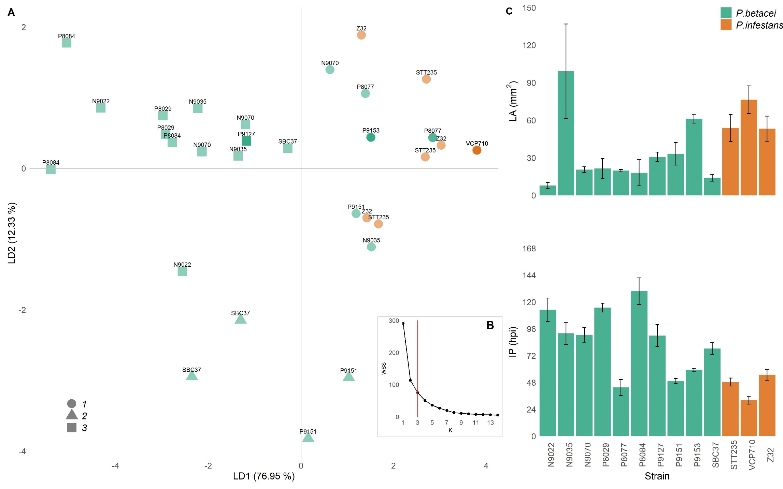
Figure 1. Strain selection. Plot of the epidemiological components of the causal agents of late blight, Phytophthora betacei and Phytophthora infestans, when infecting tree tomato plants. (A) discriminant analysis (DA) showing the first and second discriminant components. P. betacei strains are shown in green and P. infestans in orange. The discriminant analysis indicated that the strains were best differentiated by lesion area (LA) and incubation period (IP) in both discriminant components (LD1=76.19%, LD2=13.75%). Similar strains were classified in three epidemiological clusters using a K-means approach (cluster 1: circles, cluster 2: triangles, cluster 3: squares) (B) Elbow method used to select number of ideal clusters between one and 14. (C) Mean lesion area (LA, top) and incubation period (IP, bottom) of all the strains tested. Bars represent the standard error (SE) of the mean.
Notes:
#######CREATE PANEL A & B ########
##Draw LDA plot
pLDA<-ggplot(df, aes(x=x, y=y, fill = Species)) +
geom_point(aes(fill = Species, color = Species, shape = infectionCluster$cluster),
size = 6,alpha = 0.5) +
geom_hline(yintercept=0 ,color="gray") +
geom_vline(xintercept=0 ,color="gray") +
theme_minimal()+
theme(panel.grid = element_blank(),
axis.title = element_text(size = 14),
axis.text = element_text(size = 12),
legend.title = element_blank(),
legend.text = element_text(size = 14, face = "italic"),
legend.position = c(0.1,0.1)) +
labs(x = paste("LD1 (", round((prop.lda[1]*100), digits = 2), " %)", sep = "")) +
labs(y = paste("LD2 (", round((prop.lda[2]*100), digits = 2), " %)", sep = "")) +
scale_x_continuous() +
scale_fill_brewer(palette = 'Dark2', guide = FALSE) +
scale_colour_brewer(palette = 'Dark2', guide = FALSE) +
annotate('text', x = x, y=y+0.1, label = Strain, size = 3)
##Draw K-means plot
pKmeans<- ggplot(kgraph, aes(x = k, y=wss1)) +
geom_point() +
geom_line() +
geom_vline(xintercept = 3, col = "red") +
theme_minimal() +
theme(axis.title = element_text(size = 8),
panel.grid = element_blank(),
plot.background = element_rect(colour = "gray")) +
ylab("WSS") +
xlab("K") +
scale_x_continuous(expand = c(0,0.1),
limits = c(1, 14),
breaks = seq(1,14,2))+
scale_y_continuous(expand = c(0,0),
limits = c(0,300),
breaks = seq(0,300,100))
##Plot LDA with K-means as insert
LDA_epidem<-ggdraw(pLDA) + draw_plot(pKmeans, x = 0.75, y = 0.10, width = 0.25, height = 0.25) +
draw_plot_label(label=c("A", "B"), x=c(0, 0.96), y=c(1, 0.35))
#######CREATE PANEL C########
pLA<- ggplot(meanLA, aes(x = Strain, y = meanLA, fill = Species)) +
geom_col(alpha = 0.8) +
geom_errorbar(aes(ymin = meanLA - se, ymax = meanLA + se), width=0.2) +
theme_minimal() +
theme(legend.title = element_blank(),
legend.position = c(0.9,0.95),
panel.grid = element_blank(),
axis.title.y = element_text(size = 14),
axis.title.x = element_blank(),
axis.text.x = element_blank(),
axis.text.y = element_text(size = 12),
legend.text = element_text(size = 14, face = "italic")) +
ylab(bquote("LA (mm"^2*")")) +
scale_fill_brewer(palette = 'Dark2') +
scale_y_continuous(expand = c(0,0),
limits = c(0,150),
breaks = seq(0,150,30)) +
scale_x_discrete(expand = c(0,0))
pIP<- ggplot(meanIP, aes(x = Strain, y = meanIP, fill = Species)) +
geom_col(alpha = 0.8) +
geom_errorbar(aes(ymin = meanIP - seIP, ymax = meanIP + seIP), width=0.2) +
theme_minimal() +
theme(legend.position = 'none',
panel.grid = element_blank(),
axis.title = element_text(size = 14),
axis.text.x = element_text(size = 12, angle = 90),
axis.text.y = element_text(size = 12)) +
ylab("IP (hpi)") +
scale_fill_brewer(palette = 'Dark2') +
scale_y_continuous(expand = c(0,0),
limits = c(0,168),
breaks = seq(0,168,24)) +
scale_x_discrete(expand = c(0,0))
pEpide<- plot_grid(pLA, pIP, labels = 'C', nrow = 2, align = 'hv')
#######COMPLETE FIGURE########
pFig1 <- LDA_epidem + pEpide + plot_layout(design = layout, widths=c(1.25,1))

Slide 31
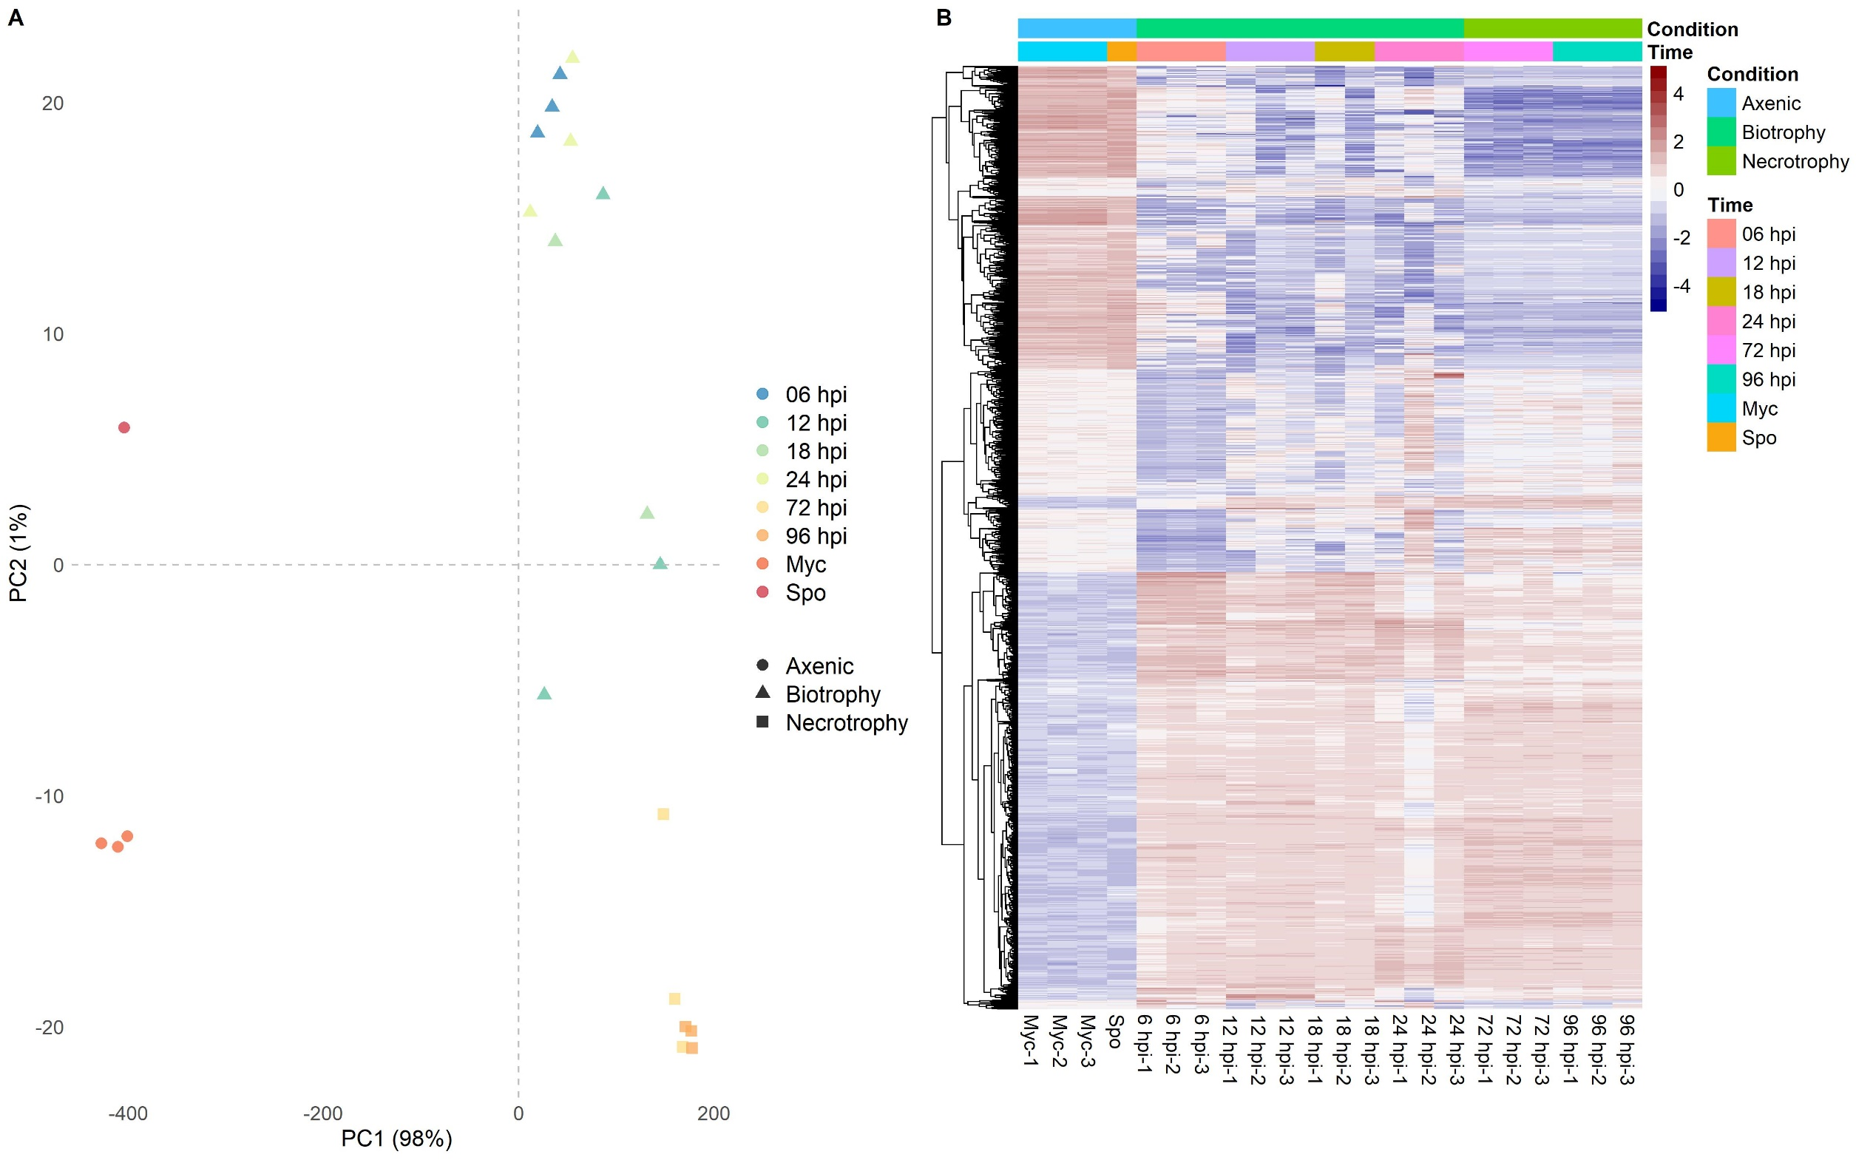
Figure 3. Transcriptional dynamics of P. betacei strain N9035 infecting tree tomato (A) Biotrophy and necrotrophy were clearly identified from transcript profiles (B) Hierarchical clustering. Shows mayor expression shifts between axenically grown samples (Myc = Mycelia, Spo = Sporangia) and in-planta (6-96 hpi), as well as biotrophy and necrotrophy infection stages.
Notes:
########HEATMAP WITH pheatmap package#######
heatmapPlot<- pheatmap(my_mat,
annotation_col = df,
show_colnames = TRUE,
show_rownames = FALSE,
labels_col=c("Myc-1", "Myc-2", "Myc-3", "Spo", "6 hpi-1", "6 hpi-2", "6 hpi-3",
"12 hpi-1", "12 hpi-2", "12 hpi-3", "18 hpi-1", "18 hpi-2", "18 hpi-3",
"24 hpi-1", "24 hpi-2", "24 hpi-3", "72 hpi-1", "72 hpi-2", "72 hpi-3",
"96 hpi-1", "96 hpi-2", "96 hpi-3"),
cluster_cols = F,
color = RowSideColors,
scale = 'column',
clustering_distance_cols = 'maximum',
fontsize = 12)
####Convert pheatmap to ggplot object
library(ggplotify)
ggHeat<- as.ggplot(heatmapPlot, scale = 1, hjust = 0, vjust = 0)

Slide 32
Abdullah Habibi

Slide 33
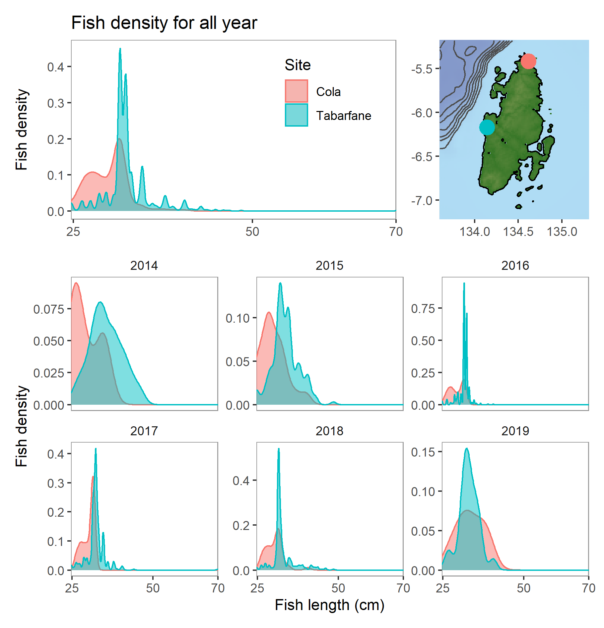
The grouper (Cromileptes altivelis) fishing in Aru island is centered in two locations, Cola and Tabarfane, in the north and east part of the island. To understand the spatial variability population of this species, the fish density for all the recorded years is plotted based on the fish length from these locations.
Notes:
highlights
Create multiplot using patchwork
Create site locations in the map
Create legend inside top plot
r code
library(ggplot2)
#plot 1 - total fish density
top1 <- ggplot(tikus, aes(Fish_indlength, fill=Site, color=Site)) +
geom_density(alpha=0.5) + ggtitle("Fish density for all year") +
theme(strip.background = element_rect(fill=NA, color=NA),
panel.background = element_rect(fill=NA, color="gray60"),
panel.grid.major = element_blank(),
panel.grid.minor = element_blank(),
legend.position = c(.80, .75), # create legend inside plot
axis.title.x=element_blank()) +
scale_x_continuous(expand = c(0, 0),
breaks = c(25, 50, 70)) +
ylab("Fish density")
#plot 2 - map
library(marmap)
# create kepulauan aru map by finding the map through google
# click left upper and right bottom of the desired area
# to get latitude and longitude coordinates as the input to get the bathymetry map
AruBathy <- getNOAA.bathy(lon1=133.595, #left upper
lon2=135.309, #right bottom
lat1=-5.176, #left upper
lat2=-7.218, #right bottom
resolution=1, # use higher resolution 1 as the area is pretty small
keep=TRUE) #keep=TRUE writes downloaded data into a file
#create a ggplot object appropriate to the bathy data object
krambaru <- data.frame("lon"=c(134.618496,134.141698),
"lat"=c(-5.417224,-6.171258),
"site"=c("Cola", "Tabarfane")) # create data frame as input to make dot for the sites in the map
top2 <- autoplot(AruBathy, geom=c('raster', 'contour'),
show.legend=FALSE) + #turn off legend
scale_fill_etopo() + #special colors
theme(axis.title = element_blank()) +
geom_point(data=krambaru, aes(x=lon, y=lat, color=site), # create different dot color for different site
size=5, alpha=1) +
theme(legend.position = "none") # turn off legend
#plot 3
bottom <- ggplot(tikus, aes(Fish_indlength, fill=Site, color=Site)) +
geom_density(alpha=0.5) + facet_wrap(~Date_year, scales="free_y", nrow=2) +
theme(strip.background = element_rect(fill=NA, color=NA),
panel.background = element_rect(fill=NA, color="gray60"),
panel.grid.major = element_blank(),
panel.grid.minor = element_blank(),
legend.position = "none") +
scale_x_continuous(expand = c(0, 0),
breaks = c(25, 50, 70)) +
ylab("Fish density") + xlab("Fish length (cm)")
#create multiplot using patchwork
library(patchwork)
grouperlayout <- '
AAB
CCC
CCC
'
top1+top2+bottom+plot_layout(design=grouperlayout)
# export to png
ggsave2("FishDensityVariability0315.png")

Slide 34
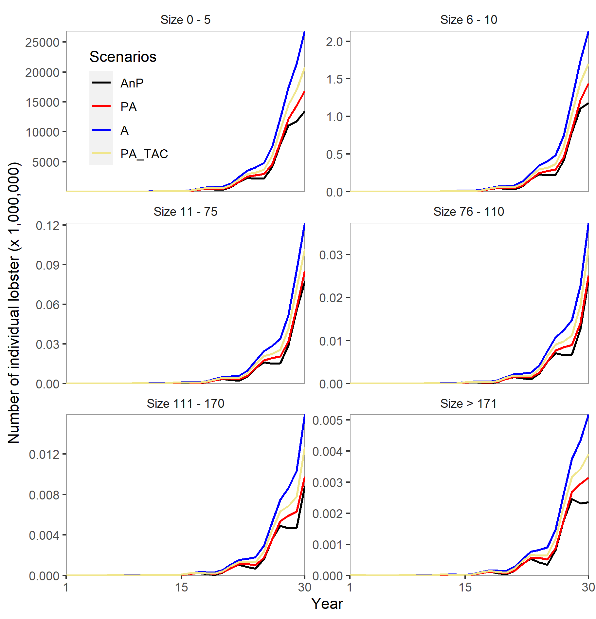
Size-structure model is employed to measure the government plan to re-open the lobster’s puerulus (post larvae) catch after the effort was closed in the past 3 years. The model will give information on the developed scenario to the eggs and larva (size 0-5 mm), post larvae (size 6-10 mm), juvenile (size 11-75 mm), sub adult (size 76-110 mm), adult (111-170 mm) and brood stock size (above 171 mm) populations. There are four developed scenarios: (i) after three years ban, puerulus and adult catch is reopened like before (AnP); (ii) no three years puerulus ban, the puerulus and adult is allowed to catch without effort control (PA); (iii) after three years ban, only adult lobster is allowed to catch (A); and (iv) after three years ban, puerulus and adult catch is reopened with Total Allowable Catch scheme (PA_TAC).
Notes:
highlights
Adding more graphic line and assign wanted colors in facet_wrap plot
Moving legend inside the left top plot
Change the title for each facet_wrap plot
r code
ggplot(data=Lob_S_longer, aes(x=Year, color=CatchOptions)) +
geom_line(aes(y=LobsPop/1e6), size=0.7) +
facet_wrap(~SizeClass, scales="free_y", nrow=3,
labeller=labeller(SizeClass=c("lengthto005" = "Size 0 - 5",
"lengthto010" = "Size 6 - 10",
"lengthto075" = "Size 11 - 75",
"lengthto110" = "Size 76 - 110",
"lengthto170" = "Size 111 - 170",
"lengthtomore170" = "Size > 171"))) +
theme(strip.background = element_rect(fill=NA, color=NA),
panel.background = element_rect(fill=NA, color="gray60"),
panel.grid.major = element_blank(),
panel.grid.minor = element_blank(),
legend.position = c(.12, .86), # create legend inside plot
legend.title=element_text()) +
scale_color_manual(name="Scenarios", labels=c("AnP", "PA", "A", "PA_TAC"),
values=c("Tot_AnP_S"="black",
"Tot_PA_S"="red",
"Tot_A_S"="blue",
"Tot_PA_TAC_S"="khaki")) +
scale_x_continuous(expand = c(0, 0),
breaks = c(1, 15, 30)) +
scale_y_continuous(expand = c(0, 0)) +
ylab("Number of individual lobster (x 1,000,000)")
ggsave2("LobsterSizeStructure0315.png")

Slide 35
Aji John

Slide 36
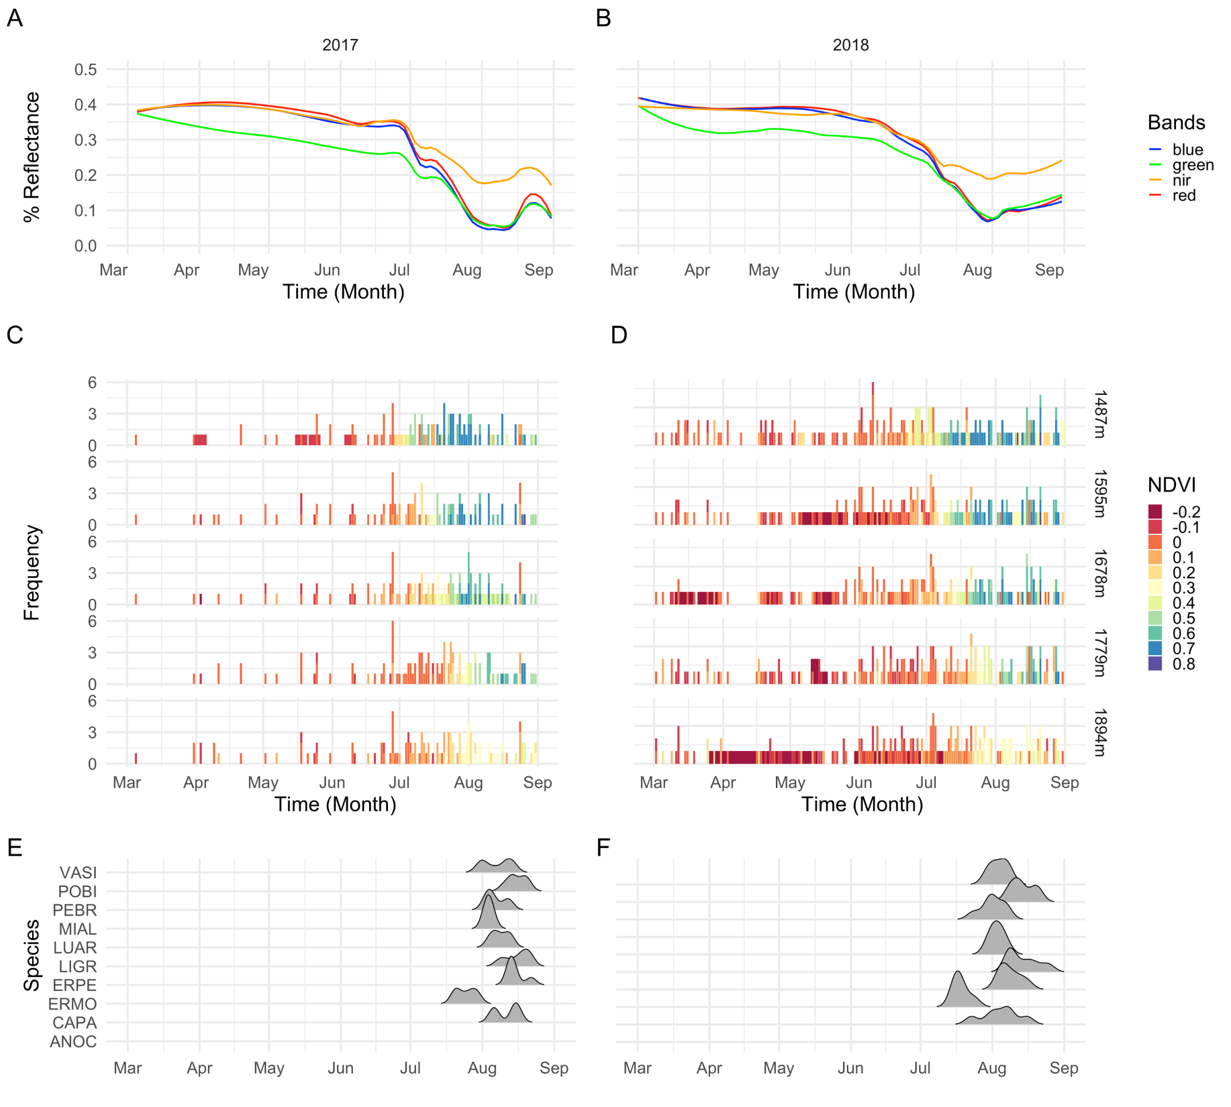
Figure 1: Satellite reflectance of meadows in years 2017 and 2018. (A) Combined reflectance profile in 2017 (B) Combined reflectance profile in 2018 (C) NDVI profile by elevation in 2017 (D) NDVI profile by elevation in 2018 (E) Peak flowering of top ten species in 2017 (D) Peak flowering of top ten species in 2018
Notes:
Lot of layout, used patchwork , color scheme and aligning

Slide 37
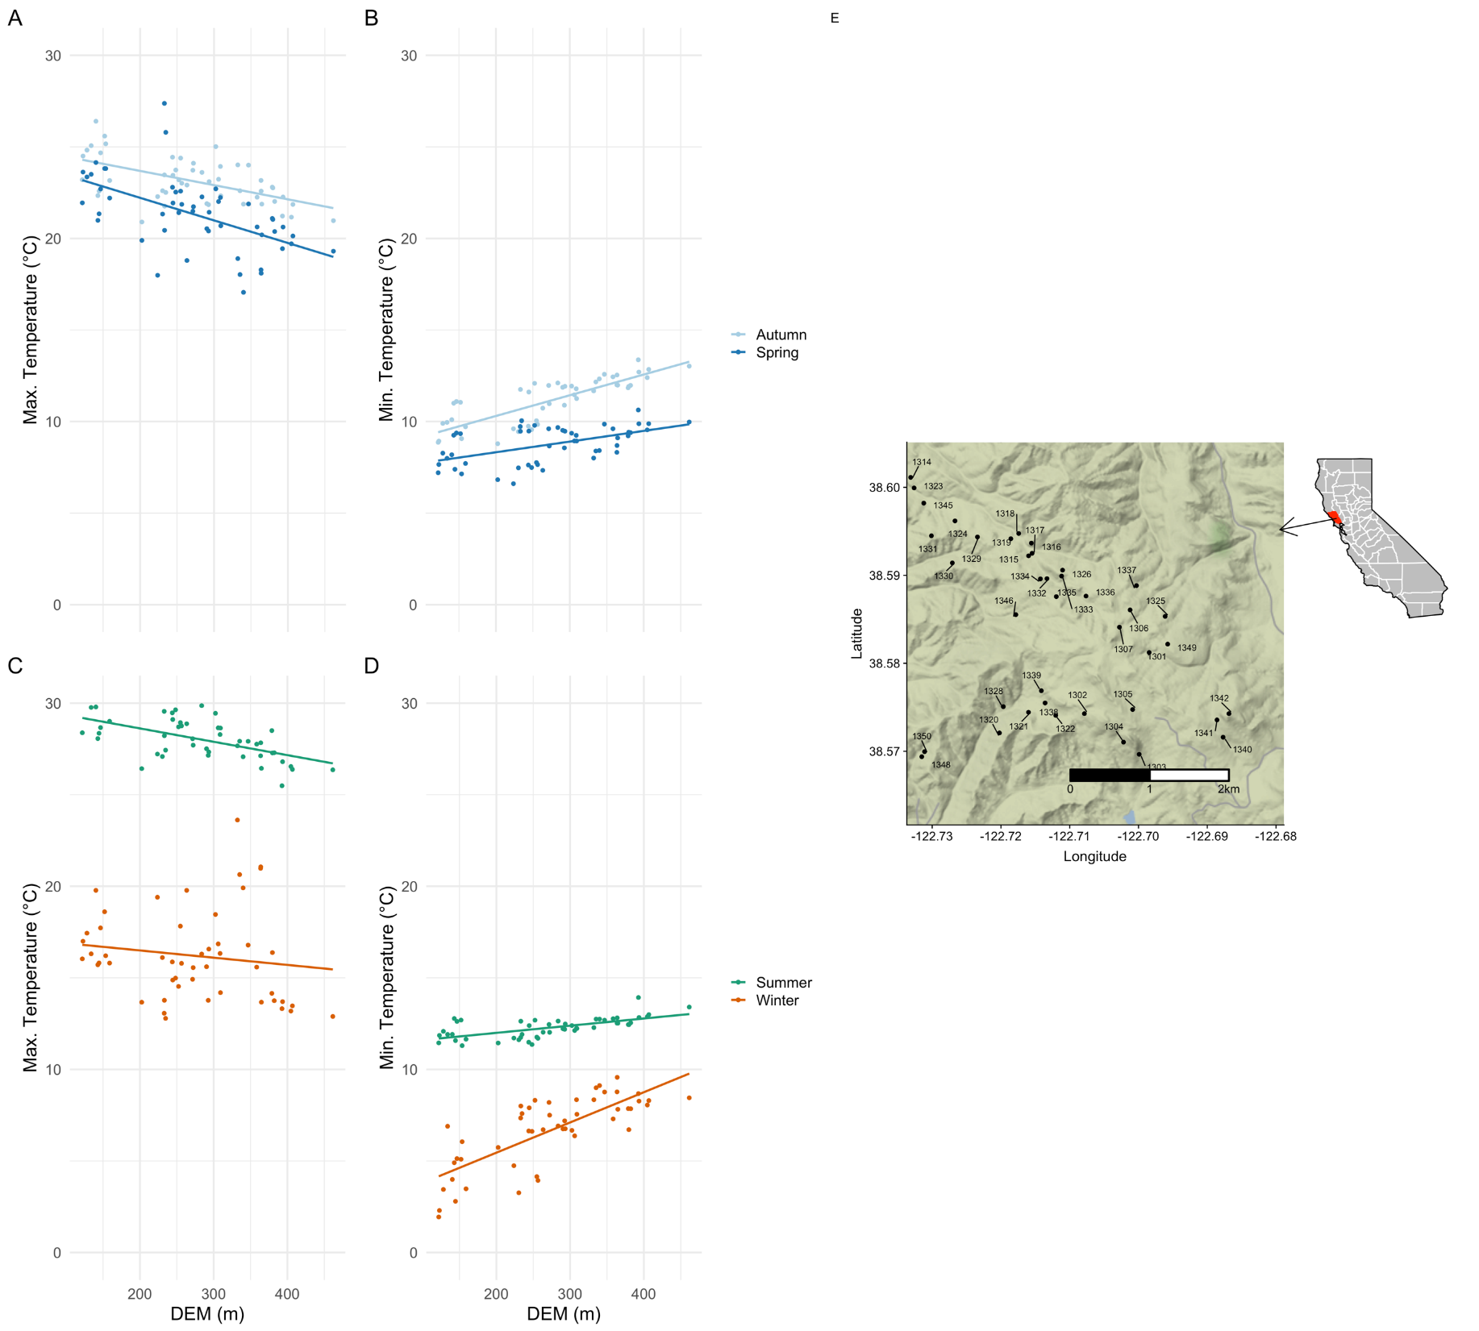
Figure 2: Seasonal minima and maxima across Pepperwood Preserve. (A) Max temperatures in spring and autumn (B) Min temperatures in spring and autumn (C) Max temperatures in summer and winter (B) Min temperatures in summer and winter (E) Map of the preserve, with dots representing weather stations
Notes:
Lot of layout stuff I learnt , doing maps, and choice of colors

Slide 38
Man Marcaida III

Slide 39
Change in timing and location (A and B) of rice sowing in Battambang and Kampong Thom provinces in Cambodia, before and after the proliferation of hydropower dams in the Mekong River.
Notes:
Note 1:
It’s cool to know that you can have a common legend for combined plots in patchwork. Code looks like this:
combined <- plot1 + plot2 & theme(legend.position = "bottom")
combined + plot_layout(guides = "collect")
There is a caveat: both plots what you want to combine should have the same items in the legend. Unless you are combining the legends of 2 entirely different plots, then it will keep both legends in the output.
I would have wanted to have all the the keys on the same line at the bottom but I can’t figure out how to do it!
Note 2:
I originally set the legend inside my area plot but when I combine with other plots in patchwork, I get this error:
Error in FUN(X[[i]], ...) : subscript out of bounds
I looked it up online and I found out that it’s a known issue. I didn’t find a solution…

Slide 40
Distribution of the most abundant macroalgal species (N3% coverage) in 27 20x20 cm quadrats taken along a pH gradient from S1 (pH=8.1), S2 (pH=7.8), and S3 (pH=6.7)
Notes:
Axis scales can be colorized but you have to create a list of the colors first before applying them to the plot. For instance:
x_cols <- c(rep("#6baed6", 3), rep("#2171b5", 3), rep("#084594",3))
y_cols <- c(rep("firebrick3", 15), rep("darkorange2", 8), rep("#008837", 2))
Then in themes:
theme(axis.text.x = element_text(colour=x_cols, face="bold"),
axis.text.y = element_text(colour=y_cols, face="italic"))
Note that I have to group the labels first:
scale_x_discrete(breaks = c("A1", "B1", "C1", "D1", "E1", "F1", "G1", "H1", "I1"),
labels=c("A", "B", "C", "D", "E", "F", "G", "H", "I"))
scale_y_discrete(limits=c(my_list$species))
Also, take note that R automatically sorts the group in alphabetical order.

Slide 41
Natalie Mastick

Slide 42
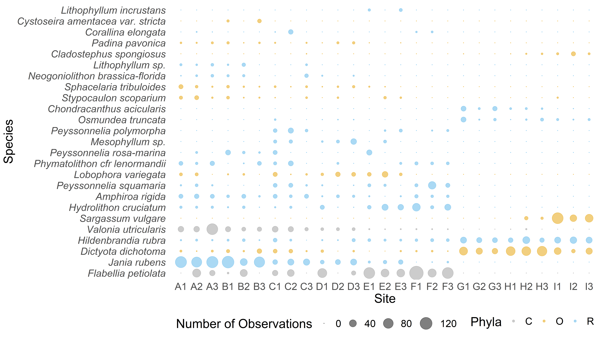
Notes:
My interpretation of Porzio et al. 2011’s figure 4. Species were surveyed across sites A-I that have a corresponding decrease in pH value from 8.1 to 7.8. The size of the bubble represents the number of observations, and the y-axis is ordered by average abundance of each species observed. Bubbles are colored by phyla of the species surveyed, C = Chlorophyta, O = Ochrophyta, and R = Rhodophyta.
For this plot, I created a bubble plot, because like a kite diagram, they represent the number of observations in a really tangible way. I ordered the data in a way that told more of a story about the least to the highest abundance species.

Slide 43
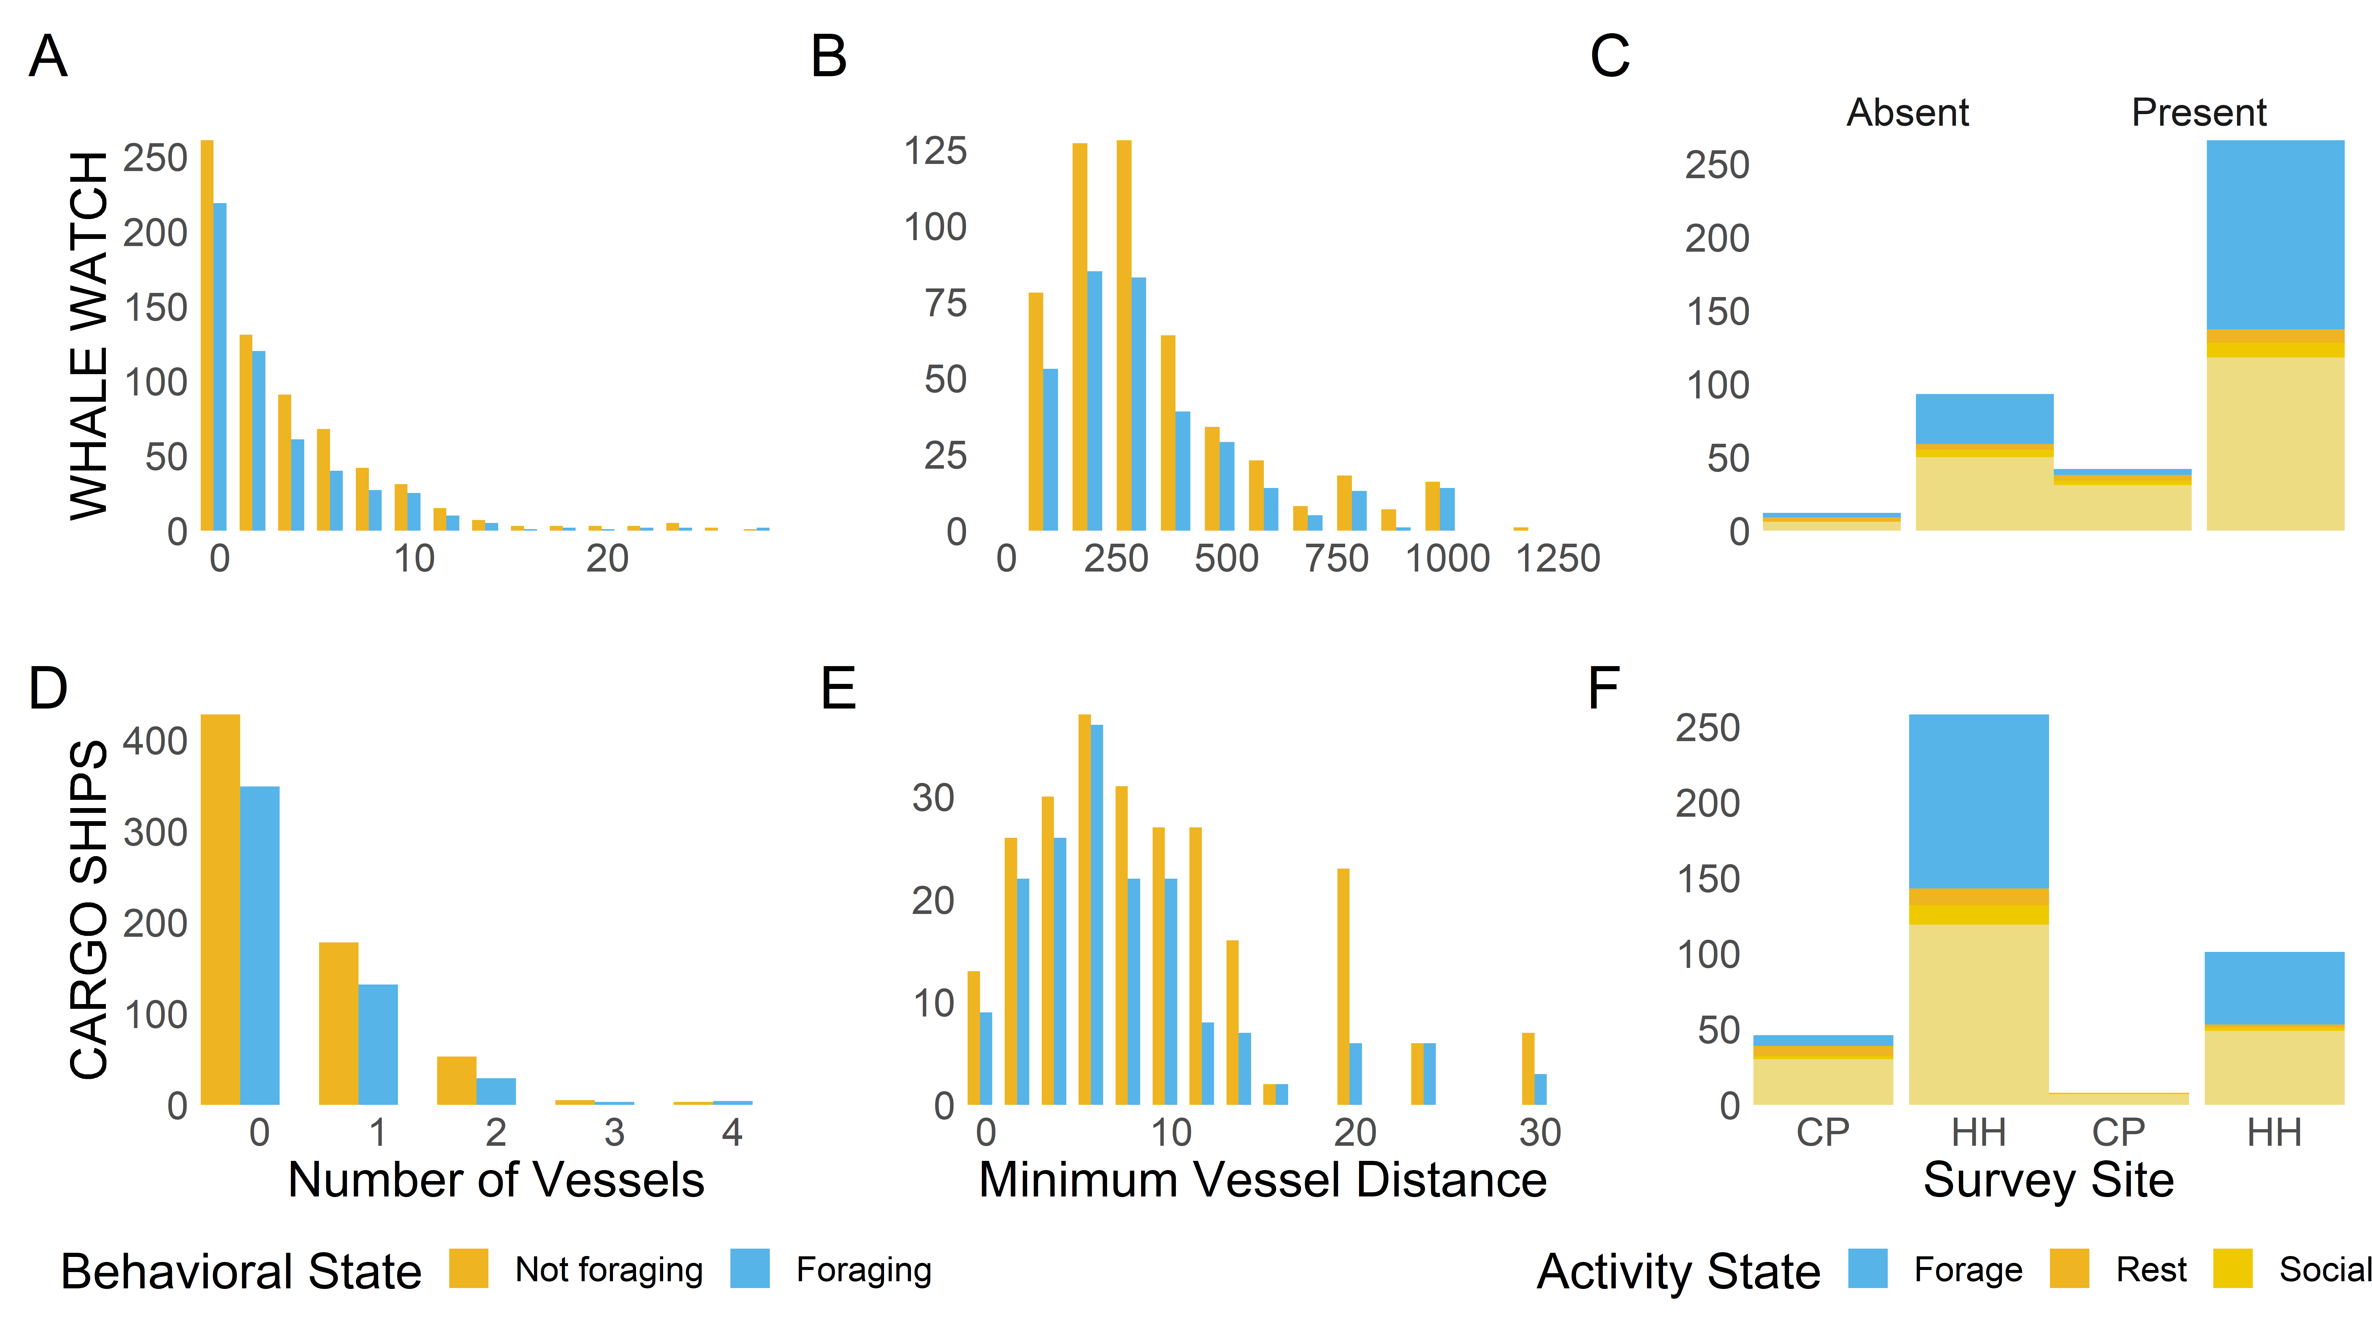
Notes:
This plot shows a variety of survey data from a two years of southern resident killer whale surveys from San Juan Islands. The leftmost plots show the number of vessels (A, whale watching, and D, cargo ships) present during killer whale sightings in 2018-2019. B and E represent the minimum vessel distance of whale watching (B) and cargo (E) vessels during sighthings in 2018-2019. C and F represent the more specific behaviors observed at each survey site in 2019 with whale watching vessels present and absent (C), and cargo ships present and absent (F).
This was a lesson in editing a lot of data and plots to get them to work together. I chose to represent relationships that I think build upon each other from left to right to read in a logical way. I also colored it in a way that made sense to me: as yellow and blue are the theme of foraging/not foraging throughout, when incorporating multiple levels of “not foraging” I wanted to stick to the same theme, using three colors of yellow to represent the sub-categories of “not foraging”.
levels(dat19new$CargoClose) <- c("Absent", "Present")
levels(dat19new$WWBoatClose) <- c("Absent", "Present")
w<-ggplot(dat19new)+aes(newLOC)+
geom_bar(aes(fill=state))+facet_wrap(dat19new$WWBoatClose)+
theme_minimal()+ theme(strip.background = element_rect(fill=NA, color=NA),
panel.border = element_blank(),
axis.line = element_blank(),
panel.background = element_rect(fill=NA, color="white"),
panel.grid.major = element_blank(),
panel.grid.minor = element_blank(),
panel.spacing.x=unit(0, "lines"),
panel.spacing.y=unit(0, "lines"),
legend.background = element_blank(),
legend.position = "none",
axis.text.x = element_blank(),
text = element_text(size = 20)) +
scale_y_continuous(expand = c(0, 0)) +
scale_x_discrete(expand = c(0, 0)) + #continuous variable on x axis, remove spacer
ggtitle("2019 Survey Data")+
ylab(" ")+xlab("")+
scale_fill_manual(name="Activity State",
values=c("#56B4E9", "goldenrod2", "gold2", "lightgoldenrod2"))
#cargo ships
c<-ggplot(dat19new)+aes(newLOC)+
geom_bar(aes(fill=state))+facet_wrap(dat19new$CargoClose)+
theme_minimal()+ theme(strip.background = element_rect(fill=NA, color=NA),
panel.border = element_blank(),
axis.line = element_blank(),
strip.text = element_blank(),
panel.background = element_rect(fill=NA, color="white"),
panel.grid.major = element_blank(),
panel.grid.minor = element_blank(),
panel.spacing.x=unit(0, "lines"),
panel.spacing.y=unit(0, "lines"),
legend.background = element_blank(),
legend.position = "bottom",
text = element_text(size = 20)) +
scale_y_continuous(expand = c(0, 0)) +
ylab(" ")+
scale_fill_manual(name="Activity State",
values=c("#56B4E9", "goldenrod2", "gold2", "lightgoldenrod2"))+
scale_x_discrete(name= "Survey Site", breaks=c("CP","HH"), expand=c(0,0))
w/c
ww1<-ggplot(alldat)+aes(`# BOATS`, fill=factor(forage))+
geom_histogram(binwidth=2,position="dodge")+theme_minimal()+
ggtitle("2018 and 2019 Killer Whale Survey Data")+
theme(strip.background = element_rect(fill=NA, color=NA),
panel.border = element_blank(),
axis.line = element_blank(),
panel.background = element_rect(fill=NA, color="white"),
panel.grid.major = element_blank(),
panel.grid.minor = element_blank(),
panel.spacing.x=unit(0, "lines"),
panel.spacing.y=unit(0, "lines"),
legend.background = element_blank(),
legend.position = "none",
text = element_text(size = 20)) +
scale_x_continuous(expand = c(0, 0)) + #continuous variable on x axis, remove spacer
scale_y_continuous(expand = c(0, 0)) +
scale_fill_manual(name="Behavioral State",
breaks=c("1", "2", "NA"),
labels=c("Not foraging", "Foraging", "NA"),
values=c("goldenrod2","#56B4E9"))+
xlab(" ")+ylab("WHALE WATCH")
ww2<-ggplot(alldat)+aes(WWBoatMinDistance, fill=factor(forage))+
geom_histogram(binwidth=100,position="dodge")+theme_minimal()+
theme(strip.background = element_rect(fill=NA, color=NA),
panel.border = element_blank(),
axis.line = element_blank(),
panel.background = element_rect(fill=NA, color="white"),
panel.grid.major = element_blank(),
panel.grid.minor = element_blank(),
panel.spacing.x=unit(0, "lines"),
panel.spacing.y=unit(0, "lines"),
legend.background = element_blank(),
legend.position = "none",
text = element_text(size = 20)) +
scale_x_continuous(expand = c(0, 0)) + #continuous variable on x axis, remove spacer
scale_y_continuous(expand = c(0, 0)) +
scale_fill_manual(name="Behavioral State",
breaks=c("1", "2", "NA"),
labels=c("Not foraging", "Foraging", "NA"),
values=c("goldenrod2","#56B4E9"))+
xlim(0, 1200)+
xlab(" ")+ylab("")
c1<-ggplot(alldat)+aes(`# SHIPS`, fill=factor(forage))+
geom_histogram(binwidth=1,position="dodge")+theme_minimal()+
theme(strip.background = element_rect(fill=NA, color=NA),
panel.border = element_blank(),
axis.line = element_blank(),
panel.background = element_rect(fill=NA, color="white"),
panel.grid.major = element_blank(),
panel.grid.minor = element_blank(),
panel.spacing.x=unit(0, "lines"),
panel.spacing.y=unit(0, "lines"),
legend.background = element_blank(),
legend.position = "bottom",
text = element_text(size = 20)) +
scale_x_continuous(expand = c(0, 0)) + #continuous variable on x axis, remove spacer
scale_y_continuous(expand = c(0, 0)) +
scale_fill_manual(name="Behavioral State",
breaks=c("1", "2", "NA"),
labels=c("Not foraging", "Foraging", "NA"),
values=c("goldenrod2","#56B4E9"))+
xlab("Number of Vessels")+ylab("CARGO SHIPS")
c2<-ggplot(alldat)+aes(CargoMinDistance, fill=factor(forage))+
geom_histogram(binwidth=2,position="dodge")+theme_minimal()+
theme(strip.background = element_rect(fill=NA, color=NA),
panel.background = element_rect(fill=NA, color="white"),
panel.grid.major = element_blank(),
panel.grid.minor = element_blank(),
panel.spacing.x=unit(0, "lines"),
panel.spacing.y=unit(0, "lines"),
legend.background = element_blank(),
legend.position = "none",
text = element_text(size = 20)) +
scale_x_continuous(expand = c(0, 0)) + #continuous variable on x axis, remove spacer
scale_y_continuous(expand = c(0, 0)) +
scale_fill_manual(name="Behavioral State",
breaks=c("1", "2", "NA"),
labels=c("Not foraging", "Foraging", "NA"),
values=c("goldenrod2","#56B4E9"))+
xlab("Minimum Vessel Distance")+ylab(" ")
(ww1+ww2+w)/(c1+c2+c)

Slide 44
Miranda Mudge

Slide 45
Figure 1: Prevalence of protein functional groups largely unknown, with dynamic changes in energy production, amino acid transport and ribosomal structure. Proteins identified via mass spectrometry to undergo significant changes in abundance compared to optimal conditions (increases shown in red, decreases shown in blue) were mapped to EggNog terms (classifying organized Gene Ontologies). A count was determined (shown in individual boxes) for each experimental condition to identify differences between temperature, salinity, and nutrient responses (ASW: Artificial Sea Water; Brine: solution with salinity calculated based on environmental equilibrium for given incubation temperature; Nutrients: additional nutrients added to sample).
Notes:
This figure uses color and numbers to consolidate information from a complex experiment in a way that immediately shows trends in measured functional ontologies.
It was hard to find a font color for the boxes that showed up in light and dark boxes but I think this works better than any other option I tried.
The figure also required layout adjustments that were helped by lecture 5.
Code:
#puts x axis names at angle
draw_colnames_45 <- function (coln, gaps, ...) {
coord = pheatmap:::find_coordinates(length(coln), gaps)
x = coord$coord - 0.5 * coord$size
res = textGrob(coln, x = x, y = unit(1, "npc") - unit(3,"bigpts"), vjust = 0.5, hjust = 1, rot = 45, gp = gpar(...))
return(res)}
assignInNamespace(x="draw_colnames", value="draw_colnames_45",
ns=asNamespace("pheatmap"))
names(both)[names(both)=='B10N.inc']<-'Brine -10°C Nutrients ‘ #change name of column
hm.col.both<-brewer.pal(9,'Blues’) #set color palette
#make a pretty heatmap
heat.1 <- pheatmap(both.plot[1:8], display_numbers = T, color = hm.col.inc,
cluster_rows = F, cluster_cols = F,show_rownames = F,
treeheight_row = 0, treeheight_col = 0, legend = T,
cellwidth=30, cellheight=15, number_format = "%.0f",
number_color = "grey65")
#set layout
lm=rbind(c(1,1,2,2,2,2),
c(1,2,2,3,3,3))
grid.arrange(grobs = list(heat.1[[4]],heat2[[4]]), layout_matrix = lm)
#save super high res, required a lot of adjusting
save_pheatmap_png <- function(x, filename, width=4300, height=5900, res = 1000) {
png(filename, width = width, height = height, res = res)
grid::grid.newpage()
grid::grid.draw(x$gtable)
dev.off()
}

Slide 46
Figure 3: ASW samples have more significantly changing proteins in all functional ontologies compared to Equilibrium brine. Proteins detected via mass spectrometry in all individual samples were grouped based on ASW or Equilibrium Brine conditions and compared to determine which Gene Ontologies (GO terms) were driving changes in abundance associated with salinity. 2362 individual proteins were plotted as background, with those significantly increased in abundance for either category highlighted by color based on respective GO terms (ASW in blue, Equilibrium Brine in orange). Significance defined as Log Fold Change >= +/- 0.5 and Z-score >= +/- 2. Proteins expressed in a functional category that are not significant shown in black. GO terms ordered by total number of identified proteins.
Notes:
This figure uses facet_wrap to highlight the proteins in each functional group in a way that still shows how they compare to the full data set in the background.
It also benefited from color theory, legend alterations, and text adjustments.
The color uses a nested if/else statement that was impossible until I learned about how to use aes and link that to legend commands.
In the normal figure, the legend fits nicely into the empty space where the figure description is now. I adjusted it to this format to allow the figure to fill the screen.
Code:
background_proteins <- tibble(Gene.Ontology = unique(set.salt$Gene.Ontology), #makes facet wrap possible
data = list(set.salt %>% rename(c2 = Gene.Ontology))) %>%
tidyr::unnest(cols = data)
background_proteins_2 <- within(background_proteins, Gene.Ontology <- factor(Gene.Ontology, levels=order.GO)) #keep row order based on manual list
background_plot.pro <- background_proteins_2 %>%
ggplot() +
geom_point(aes(x=LogFoldChange.Salinity, y=abs(Zstatistic.Salinity),
group = c2, color = "gray90"), size = 1) +
geom_point(data = set.salt,
aes(LogFoldChange.Salinity, abs(Zstatistic.Salinity),
color = ifelse(high, 'darkorange1', ifelse(low , 'dodgerblue1', 'gray30'))), #put in 3 colors based on significance
shape=16, size=1.4,
show.legend = FALSE) +
facet_wrap(~Gene.Ontology, labeller = label_wrap_gen(width=30), ncol = 6) + #wraps GO terms
theme(strip.background = element_rect(fill=NA, color=NA), #label background
panel.background = element_rect(fill=NA, color="gray50"),
panel.grid.major = element_blank(),
panel.grid.minor = element_blank(),
panel.spacing.x=unit(0, "lines"),
panel.spacing.y=unit(0, "lines"),
strip.text.x = element_text(size = 17),
axis.text=element_text(size=13),
axis.title=element_text(size=15),
plot.title = element_text(size = 18),
legend.position = 'bottom', #legend changes
legend.key = element_blank(),
legend.background = element_blank(),
legend.title = element_blank(),
legend.text=element_text(size=16),
legend.direction = "horizontal") +
scale_x_continuous(breaks = c(-4,-2,0,2,4)) +
scale_y_continuous(expand = c(0, 0)) +
guides(colour =guide_legend(override.aes=list(size=3.5))) + #this allows for colors to work in the legend
scale_color_identity(breaks = c("dodgerblue1","darkorange1", "gray30","gray90"),
labels = c("ASW","Equilibrium Brine", "Not Significant", "Different Ontology"),
guide = "legend")+
ylab("Z-statistic") +
xlab("Log Fold Change") +
ggtitle("Proteins Significantly Increased in Abundance by GO Terms: ASW vs Equilibrium Brine Samples" )
background_plot.pro
ggsave(file="volcano.multi.color.pdf",width=25, height=15)

Slide 47
Nicholas Nagengast

Slide 48
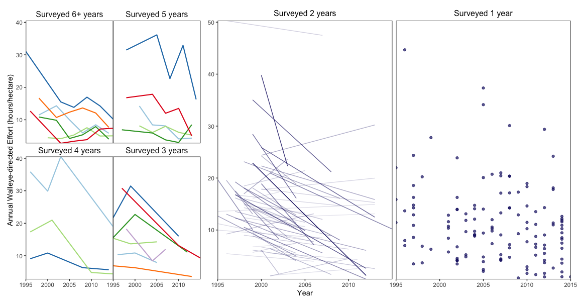
Nagengast Figure 1: How effort has been monitored for a system of lakes, as well as how effort on each lake has changed. Will be paired with a similar plot displaying abundance changes over time, which will allow readers to compare abundance and effort changes for individual lakes surveyed more than 2 years.

Slide 49
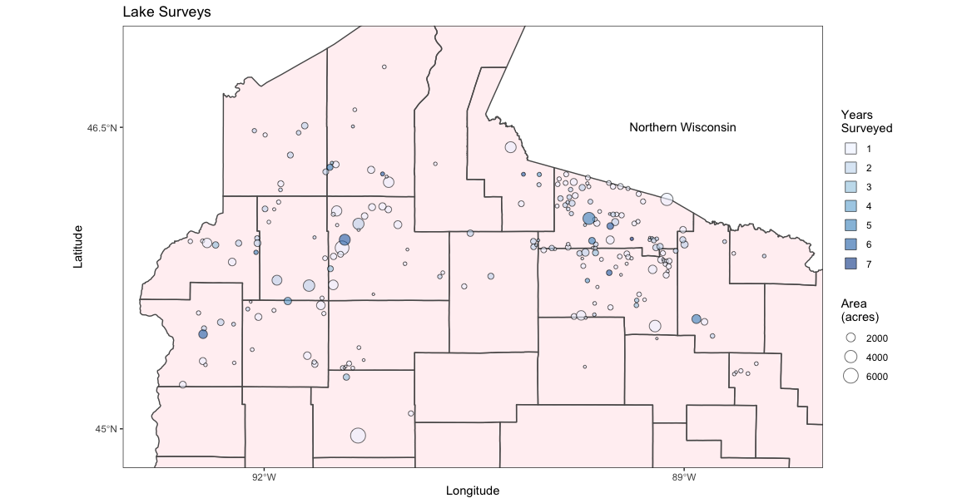
Nagengast Figure 2: How survey attention (the number of years each lake is surveyed) is related to geographic location and lake area.

Slide 50
Bob Oxborrow

Slide 51
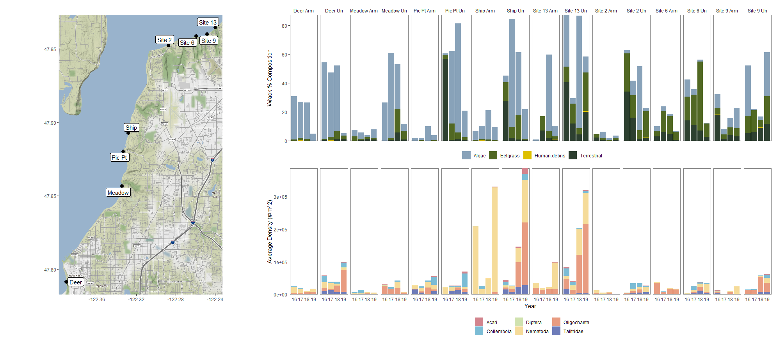
Fig 1. Composition of wrack observed in quadrats and average density of invertebrates in core samples. Samples were collected before and after shoreline restoration or nourishment at both armored (Arm) and unarmored (Un) sites.
Notes:
Fig 1. Composition of wrack observed in quadrats and average density of invertebrates in core samples. Samples were collected before and after shoreline restoration or nourishment at both armored (Arm) and unarmored (Un) sites.
Would like to make the labels on top stacked if possible. Would like the site name (ex. Deer) on top of both relevant boxes and have “Un” and “Arm” directly above the boxes. Anyone know how to do this?
Also want to squish the bar plots closer to the map.
Code:
#GRAPHS
snorack.plot.2 <- ggplot(snorack.long, aes(x=Year, y=value, fill=name)) +
geom_col() +
theme_classic() +
theme(strip.background = element_rect(fill=NA, color=NA),
panel.background = element_rect(fill=NA, color="gray50"),
panel.grid.major = element_blank(),
panel.grid.minor = element_blank(),
axis.title.x=element_blank(),
axis.text.x=element_blank(),
axis.ticks.x=element_blank(),
legend.title = element_blank(),
legend.position = "bottom") +
scale_fill_manual(values=c("#88a2b9", "#516823", "#dec000", "#2d4030")) +
ylab("Wrack % Composition") +
facet_grid(.~comb)+
scale_y_continuous(expand = c(0, 0))
snoinv.plot.2 <- ggplot(snoinv.long, aes(x=Year, y=value, fill=name)) +
geom_col() +
theme_minimal() +
theme(strip.background = element_blank(),
panel.background = element_rect(fill=NA, color="gray50"),
panel.grid.major = element_blank(),
panel.grid.minor = element_blank(),
legend.title = element_blank(),
strip.text = element_blank(),
legend.position = "bottom") +
scale_fill_manual(values=c("#d2848d", "#7bbcd5", "#d0e2af", "#f5db99",
"#e89c81", "#6e7cb9")) +
ylab("Average Density (#/m^2)") +
xlab("Year") +
facet_grid(.~comb) +
scale_y_continuous(expand = c(0, 0))
#MAKE THE MAP
#import data
gps.points <- read_csv("Snoho GPS.csv")
snoho_bbox <- make_bbox(data = gps.points, lat = Lat, lon = Long)
snoho_bbox
# grab terrain map from google
wa_terrain <- get_map(location = snoho_bbox, source = "google",
maptype = "terrain")
snoho_map <- ggmap(wa_terrain) +
geom_point(data=gps.points,
mapping=aes(x=Long, y=Lat),
color='black', size=3) +
geom_label_repel(
aes(x=Long, y=Lat, label=Site),
data = gps.points,
size = 4,
box.padding = 0.2, point.padidng = 0.3,
segment.color = "grey50") +
theme(axis.title.x=element_blank(),
axis.title.y = element_blank())
#combine everything
layout<-
"ABB
ACC"
snoho_map + snorack.plot.2 + snoinv.plot.2 +plot_layout(design = layout)

Slide 52
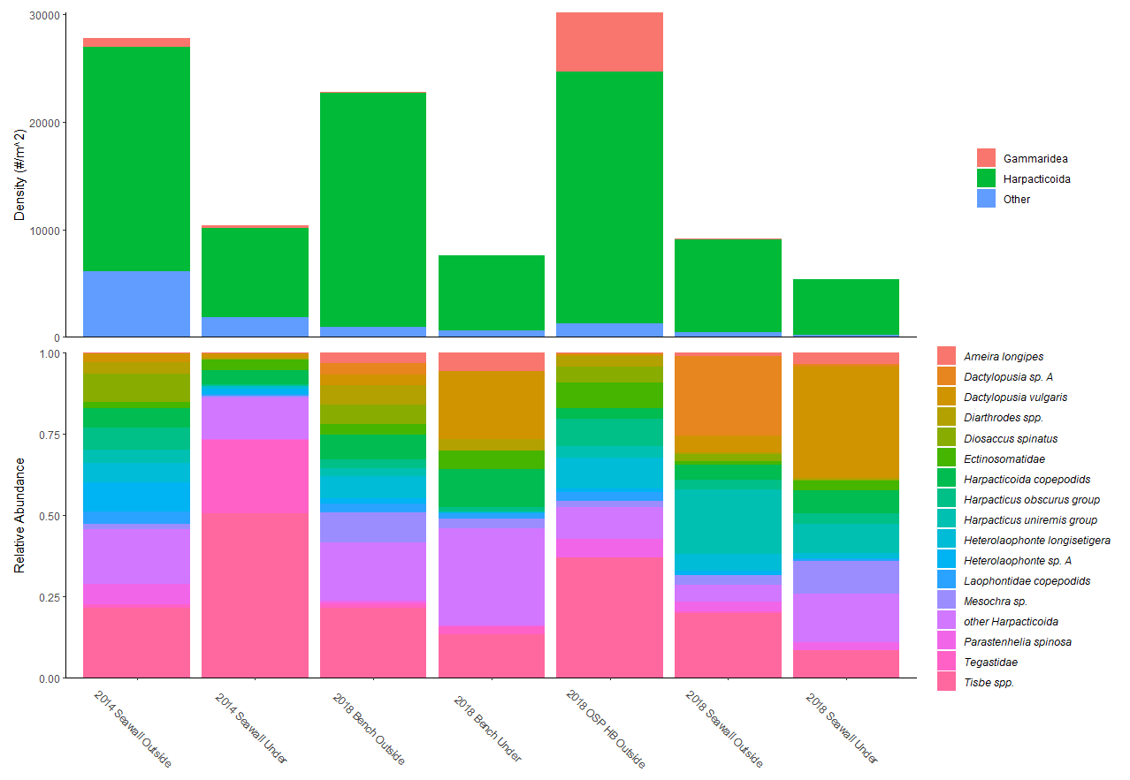
Fig 2. (Top) Density of major taxonomic groups collected along the Seattle seawall prior to the seawall replacement (2014) and after seawall replacement (2018). (Bottom) Relative abundance of Harpacticoid copepods.
Notes:
Fig 2. (Top) Density of major taxonomic groups collected along the Seattle seawall prior to the seawall replacement (2014) and after seawall replacement (2018). (Bottom) Relative abundance of Harpacticoid copepods.
Suggestions on what to do with color is appreciated. Reducing the number of taxa is not an option. (This is reduced from ~100 taxa already).
Code:
#plot 1
harp.plot <- ggplot(harps, aes(x=site, y=value, fill=name)) +
geom_col(position = "fill") +
theme_classic()+
theme(axis.title.x=element_blank(),
legend.title = element_blank(),
legend.text = element_text(face = "italic"),
axis.text.x = element_text(angle = -45)) +
ylab("Relative Abundance")+
scale_y_continuous(expand = c(0, 0))
#plot 2
rel.plot <- ggplot(swepi, aes(x=site, y=value, fill=name)) +
geom_col(position = "stack") +
theme_classic() +
theme(axis.title.x=element_blank(),
axis.text.x=element_blank(),
axis.ticks.x=element_blank(),
legend.title = element_blank())+
ylab("Density (#/m^2)") +
scale_y_continuous(expand = c(0, 0))
#combine the plots
layout<-
"A
B"
rel.plot + harp.plot +plot_layout(design = layout)

Slide 53
Christina Rathwell

Slide 54
Figure 1. A. Location of gas vents of Castello Aragonese on Ischia Island, Italy, showing 3 sectors (S1-S3). B. Summary of counts of 25 most abundant algae in the 3 sectors, separated by phylum type. C. Distribution of the top 25 most abundant algae species across each quadrat within each sector.
Notes:
I thought that the really significant points from the original Porzio figure were how greatly the representation from the different phyla changed across the 3 varying pH sites. The individual species information was also important, but was sort of a subset of the information and could be overloaded without the summary information from panel B in this figure. I wanted it to be clear which species were represented from each phylum so I split them up in the figure in panel C, and colored the species names. I found it difficult to compare color depth across different colors so I made relative abundance be in grey for all. In this way you can see which species were significant contributors to counts in each region, as a subset of the summary information in figure B. In order to do this I chose to make 3 separate dataframes of the different values for Phylum factor.
[for example: RedPorz <- PorzioLong[PorzioLong$Phylum=="(R)",]] Getting them all to be equal spaced out (rather than 3 panels of equal size, but varying widths between species rows) took some trial and error but my final grid was:
p2 <- plot_grid(rp, gp, bp, align = "hv", axis="tblr", rel_heights = c(18,4,10), nrow=3) #where rp is red algae, gp is green algae and bp is brown algae
p1p <- plot_grid(NULL, p1)
pall<-plot_grid(p1p, p2, nrow=2)

Slide 55
A
B
Frequency
Figure 3. A. The distribution of viral sequences found (in thousands of bases) versus each cluster’s (bins of DNA contiguous sequences) total size(in millions of bases) of the entire water sample. The smallest genome sizes of microbes found in this data set are approximately 1 million bases, and the smallest virome size is estimated to be 10 kb. The graph shows each of those cutoffs. Diameter of dot is proportional to the completeness of each cluster as determined by marker genes present. B. All dots meeting both cutoffs are displayed, to show frequency of virus host pairs per taxonomical order. Bars of the same color are within the same phylum.
Notes:
This is a major summary graph of my work. My project is using a novel molecular technique to pair viruses with hosts in metagenomic data. We cluster metagenomic data (dna sequences) and find clusters that contain both microbial dna and viral dna. It’s hard to say that a cluster is one complete genome, so in order to avoid that I’ve applied some filtration metrics (viruses at least 10,000 basepairs and host sequence that sums to at least a million basepairs) in order to say just how many novel virus host pairs were discovered. You generally get a picture of how big clusters are and how much virus we found in them. The data is heavily scrunched by the margins, but the most important information is the general spread, and the dots that pass the filtration metrics. Therefore there is a summary graph to the right that counts every dot that met those metrics. The hardest part about this graph was getting colors right. I had to define a specific palette that I wanted, where colors across a supergroup were similar and very different phyla had very different colors. I therefore had to just determine how many items were in a phyla and create a palette for them. Additionally I wanted Orders (the multiple taxa within a given phyla, for example all those purple bars are all proteobacteria but are different orders of proteobacteria) to be explicitly stated, but without drowning out the viewer in different qualitative colors. We can see that proteobacteria dominate, but we also get the specific information about which proteobacteria are represented.
Additionally I made sub dataframes of all clusters that met my filtration cutoff and then used table() to generate counts for the frequency plot in panel B.
HoodCanalMeta1M<-HoodCanalMeta[HoodCanalMeta$Genome_size>=1000000,]
HoodCanalMeta1M_vir<-HoodCanalMeta1M[HoodCanalMeta1M$Virus.Size>=10000,]
counts1M_vir<- table(HoodCanalMeta1M_vir$Order)
counts1M_vir_MIN<-counts1M_vir[counts1M_vir>0]

Slide 56
Rory Spurr

Slide 57
Figure 4: Heat map showing macroalgal percent cover from Porzio et al. (2011). A1-C3 were located in sector S1 with pH 8.14. D1-F3 were located in sector S2 with pH 7.83 and G1-I3 were located in sector S3 at pH 6.57.
Notes:
Reordered the organisms on the y-axis in the order Porzio used (to show percent coverage increasing in more acidic environments towards the bottom. I used factor() then manually inputted all the organisms names in the order porzio used. This seemed like a long way of doing something that should be easy so if anyone else knows how to do this in a better way please share
Italicized the organism names by saving the correct text specifications - y_axis_text = element_text(face = "italic", size = 10) and then added it the plot using theme(axis.text.y = y_axis_text)
Created the heat map using geom_tile(aes(fill = `Percent Cover`))
Used scale_fill_gradient(low = “white”, high = “blue”) to color code heat map
Cant figure out how to add lines describing what the quadrats mean (A-C = 8.0 pH etc.) so help on that would be appreciated.

Slide 58
Figure 2: Bar chart showing haplotype frequencies of the Zona Pellucida gene in Pacific Cod (Gadus macrocephalus). Map (below) shows the location of the 15 sampling sites used in the study. Sampling site are colored by basin, locations with like colors belong to the same basin. Different basins represent different and novel environments from the other basins in the study. Locations within the same basin thus have similar environmental conditions.
Notes:
Created bar chart using geom_col() and used position_dodge2(width = 2, preserve = "single”) to create bars of the same width
Reorder the bars using factor() to reorder bars with their geographic location on the bottom map
Created the map by downloading world data for Canada, Russia, United States, etc. and used geom_polygon() to plot them
Saved my latitude/longitude data as a .txt file and then added it to the map using geom_point and colored them by basin
Ex of point code looks like geom_point(data=full_set[(full_set$Basin == "Eastern Bering Sea"),], aes(x=Long_360, y=Latitude), shape= 19,size = 4, color = BER), thus had to include basin in .txt file in order to plot all the points with similar basin as one color
Used the pegas() package for haplotype creation

Slide 59
Rebekah Stiling

Slide 60
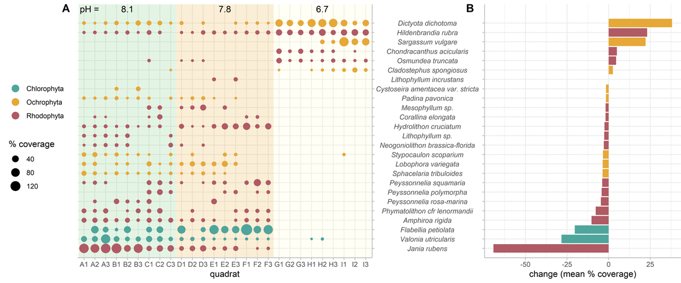
Animation 1. Changes in macroalgae amount (% lab tray coverage) from each quadrat (A) demonstrate shifts in abundance across an environmental gradient ranging from pH 8.1 to 6.7. The mean abundance (% lab tray coverage) of each species in quadrats A-C compared with quadrats G-I (B) show that several species of macroalgae are absent from the most acidic environments (e.g. Jania rubens, Valonia utriclaris, Flabelia petiolate) as new species arise or increase in abundance (e.g. Dictyota dichotoma, Sarcassum vulgare, Chondracanthus acicularis). [Note: This is an animation that alternates between with and without panel gridlines every 8 seconds (visible from slideshow mode). Hopefully, you can help me determine which to commit to. I enjoyed making my first gif, albeit simple!]
Notes:
Graphical techniques that I learned:
Plot A. I didn’t like that the default plotted points for the values of zero, so for my size call for the points I used ‘size = ifelse(coverage==0, NA, coverage))’ so points are only plotted when the microalgae species was actually in the quadrat sample. Here, zeros in the data plot nothing.
Plot A. Adding the background shaded rectangles.
I used ‘annotate("rect", xmin = 0.5, xmax = 9.5, ymin = 0, ymax = 27, alpha = .2, fill = "#78c679")’ (repeat 2x more times with new xmin, xmax, and fill color.)
It turns out we still use x and y values to describe the position of the shaded area in plot, even if the data is categorical on both axis. The lower left point is assumed to be at x = 1, y =1 and each data row is a unit of 1. I expanded the rectangle above the original plot to make room for the pH text as well.
I added a second call of geom_point() after plotting the rectangles. The rectangles initially were a layer on top of the original points, making the original points faded. However when I moved the geom_point() call to after the rectangle annotation call, I would get an error. So I just added the geom_point() call again, and they are replotted on top of the shaded rectangle. So I plotted each point twice!
I added an invisible rectangle to plot B so that the y-axis was expanded in the same way as plot A. That way, the tick marks all lined up together nicely.
Pushing two plots next to each other so they could share the axis labels.
For plot A, I moved the legend to the left and the scale to the right, but then didn’t write the text using ‘theme(axis.text.y = element_blank())’.
For plot B, I changed the left margin to -30 (-30, expanded it to the left) with ‘theme(plot.margin = margin(t=0,r = 0,b =0,l = -30)’ I believe these values are pixels, and so it was trial and error related to the size I wanted the plot and the distance from plot A.
I used ‘theme(axis.text.y = element_text(hjust=.5,face = "italic"))’ to center justify (the hjust scale is from 0-1, left-right, so .5 means center) and italicize the macroalgae labels.
When I put plot A and B together, I wanted the labels A and B near the actual plot area, so I used ‘plot_grid(label_x = c(.15,.25))’ to move the labels along the x axis away from where they naturally would be.
4) I used gifmaker.me to make this gif that bounces between two versions of the plot, with vs without gridlines (only works in ppt slideshow mode). I took my original ‘plot + theme(panel.grid.major = element_blank)’ to ensure everything else stayed the exact same. I don’t know whether I prefer with or without gridlines. What do you prefer?

Slide 61
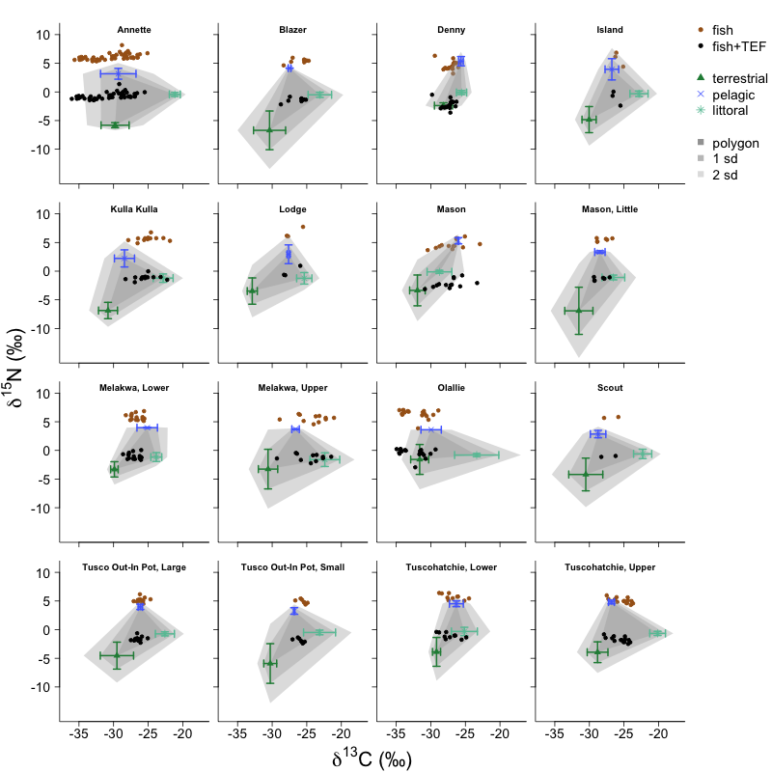
Figure 2. In lake ecosystems, plants and algae in three habitats - littoral (submerged illuminated edge), pelagic (open water) and terrestrial (land surrounding the lake) – convert CO₂ into forms of carbon that are usable to the rest of the food web through photosynthesis. Natural differences in the frequency that atoms contain extra neutrons occurs among these three habitats (greater values reflect higher occurrences of atoms with an extra neutron). Estimates of the importance of each habitat to each fish are obtained by comparing the values in the fish tissue to the values observed in plant tissue from each habitat. The shading gives a sense of uncertainty around source values, lighter gray is more unlikely.
Notes:
NOTE: When fish consume prey, the carbon assimilates into their tissue and takes on extra neutrons in away that reflects the prey, however the body tissue tends to hang onto the nitrogen compounds with the extra neutrons and excretes the normal nitrogen. So nitrogen in the tissue of an organism always has more nitrogen with an extra neutron (nitrogen-15) than the prey, a value that is then adjusted. That adjustment is called a Trophic Enrichment Factor (TEF).
This plot is created in base R. One of my takeaways of working with both systems is the miracle that is “facet_wrap()” in ggplot. In base R, to create these 16 panels, I created a loop that goes through data each lake one at a time, but to get the axis different for four types of plots (y only, x only, x and y, and none) I had to write several if-else statements (about 15 lines of code). Facet_wrap() is mind blowing in this regard.
I am working to create a similar plot with ggplot, but a few things have not been ironed out. For example, in base I’m comfortable plotting and doing calculations simultaneously (ie, means and sd for plants, or trophic adjustments for fish). Also, I’m creating hulls based on the vertices of the calculations. It is straightforward to handle different dataframes differently in base, as I work on layers of a plot.
I’m struggling to do different things with different types of data in ggplot(). I trust it will come, but the first big realization is that my original data needs to be in one giant dataframe, which is a new approach and different starting point.
Comment: Each panel is called an isotope biplot and for my research, an isotope biplot for each lake is expected, even if the plot ends up in the supplementary materials of a publication. My goal is to get as much “required” information into as clean of a space as possible.

Slide 62
Ashley Townes

Slide 63
